Slide 1
Qcells Malaysia MES Implementation
User Manual
사용자매뉴얼
2025.10.20

Slide 2
Document Control
Drafted By (작성자) | Kyoungtae Lee (이경태)
Draft Documentation Date (최초작성일자) | 2025-10-20
Final Revision Date (최종수정일자) | 2025-10-20
Ver. (버전) | Date (날짜) | Reason for Revision (개정 사유) | Written By (작성자)
1.0 | 2025-10-20 | Create document | Kyoungtae Lee

Slide 3
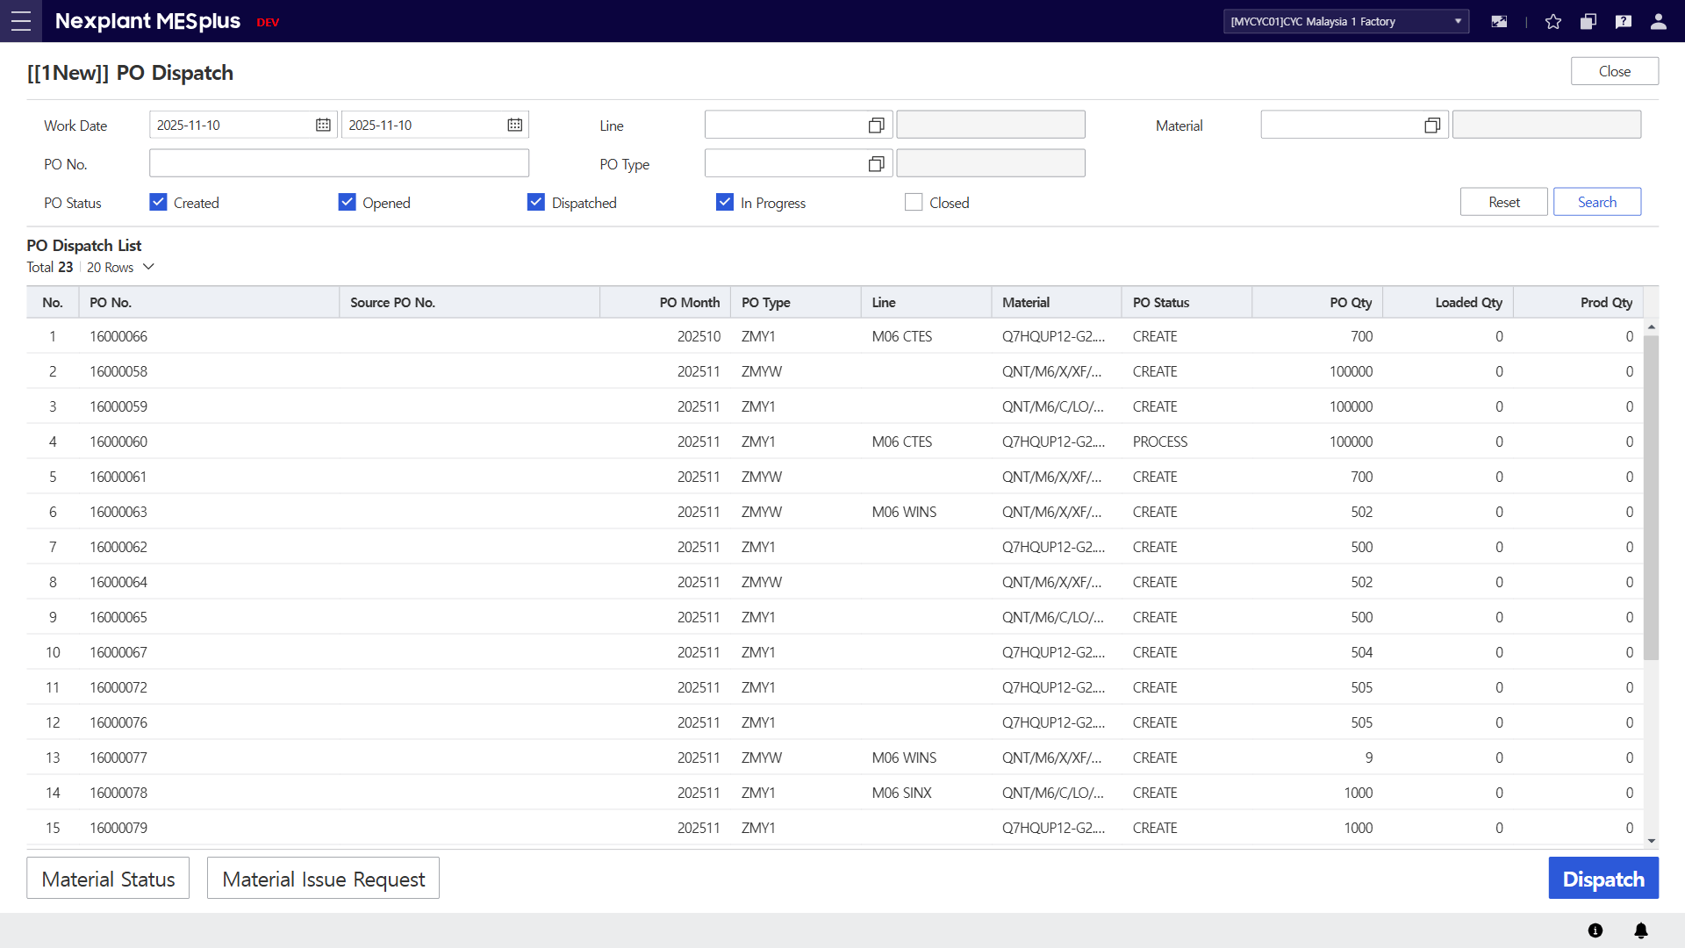
1. PO Dispatch
Main Menu | WIP (Production Management) | Sub Menu | Work Order (작업지시) | UI Name | PO Dispatch | Program ID | 20155
UI | Description
 | 1. Enter the search conditions to retrieve PO dispatch list. 2. Click the [Search] button to display the PO dispatch list in the grid according to the search conditions. 3. Click the [Reset] button to clear all fields on the screen. 4. The PO list will be displayed in the grid, including details. 5 Click the [Dispatch] button to dispatch a selected PO. Send PO dispatch I/F to ERP. 6. Click [Material Status] button to redirect to selected PO’s material to Material Status OI. 7. Click [Material Issue Request] button to redirect to issue request the selected PO’s material. 8. Click the [Close] button to exit the OI.
8
1
3
2
4
6
7
5

Slide 4
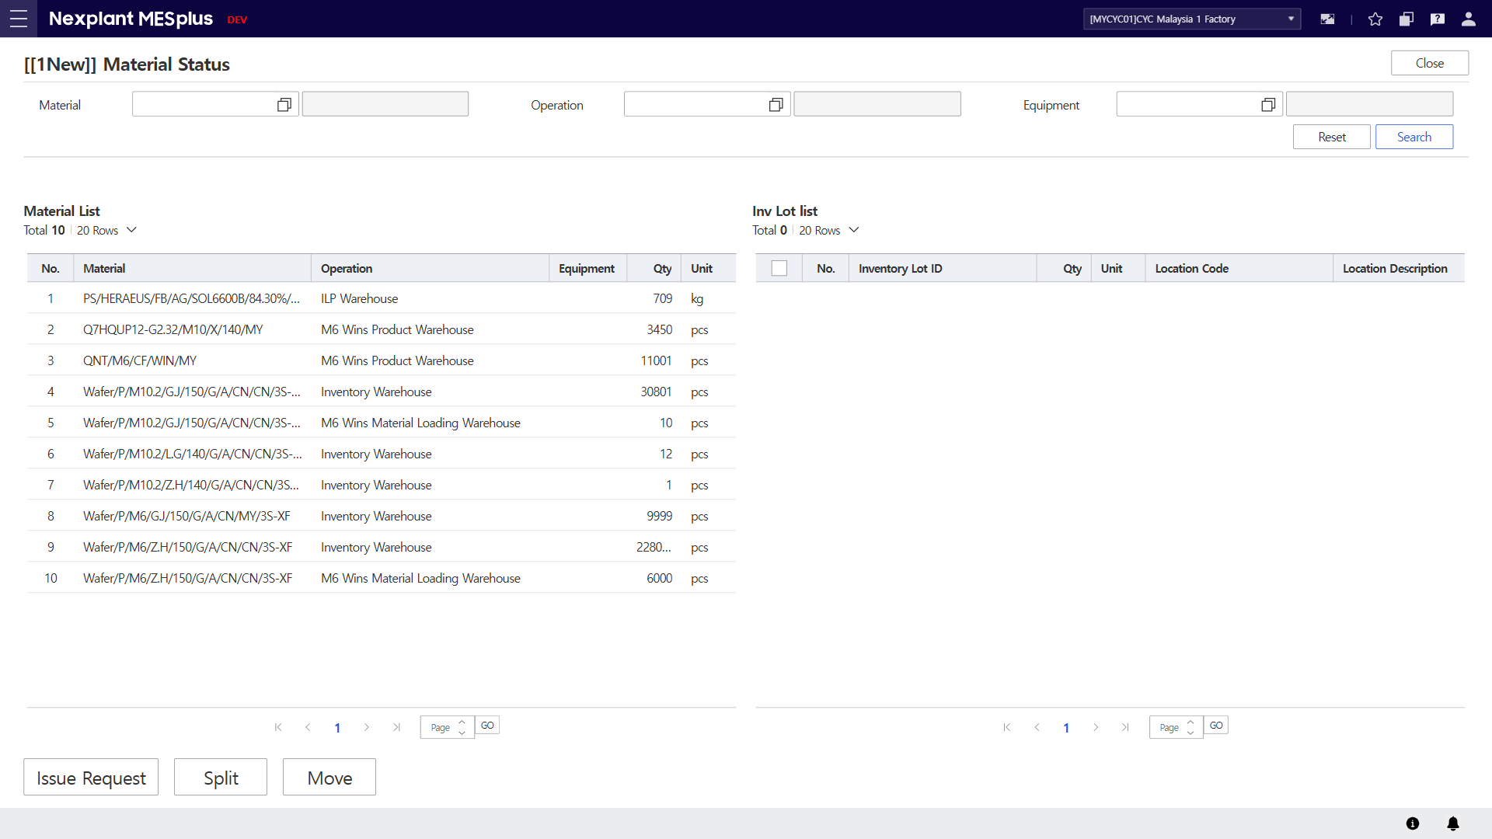
2. Material Status
Main Menu | INV (Warehouse Management) | Sub Menu | INV Mat Mgt. (자재 관리) | UI Name | Material Status | Program ID | 20195
UI | Description
 | 1. Enter the search conditions to retrieve material list. 2. Click the [Search] button to display the material list in the grid according to the search conditions. 3. Click the [Reset] button to clear all fields on the screen. 4. Material items will be displayed in the grid according to the search conditions. Select an material to display inventory LOTs in the Inv Lot list. 5. Inventory Lot will be displayed in the grid according to the selected material. 6. Click [Issue Request] button to redirect selected inventory lot to Material Issue Request OI. 7. Click [Split] button to redirect selected inventory lot to Material Split OI. 8. Click [Move] button to redirect selected inventory lot to Material Move OI. 9. Click the [Close] button to exit the OI.
9
1
3
2
4
5
6
7
8

Slide 5
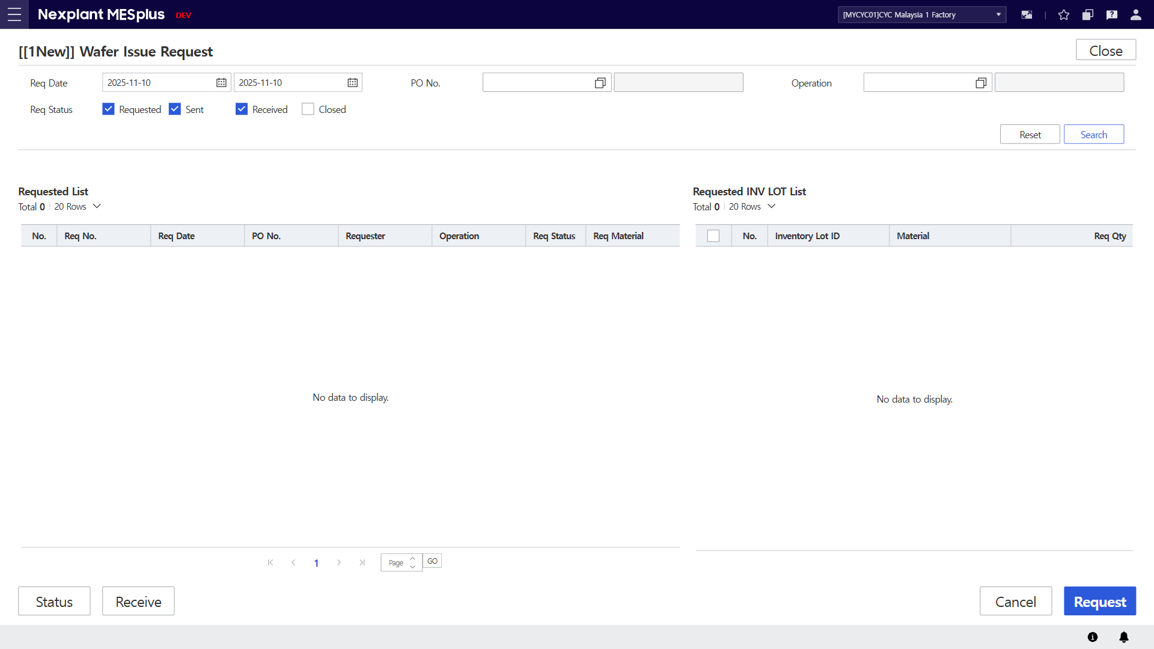
3. Wafer Issue Request
Main Menu | INV (Warehouse Management) | Sub Menu | INV Mat Mgt. (자재 관리) | UI Name | Wafer Issue Request | Program ID | 20205
UI | Description
 | 1. Enter the search conditions to retrieve wafer requested list. 2. Click the [Search] button to display the requested list in the grid according to the search conditions. 3. Click the [Reset] button to clear all fields on the screen. 4. Requested list will be displayed in the grid according to the search conditions. Select a requested item to display wafer inventory LOTs in the requested inventory lot list. 5. Wafer inventory lots will be displayed in the grid according to the selected requested item. 6. Click [Request] button to create wafer issue request and send create reservation I/F to ERP. Operation is required to be selected. 7. Click [Cancel] button to cancel issue request and send cancel reservation I/F to ERP. 8. Click [Status] button to redirect selected inventory lot to Material Status OI. 9. Click [Receive] button to redirect selected inventory lot to Material Receive OI. 10. Click the [Close] button to exit the OI.
10
1
3
2
4
5
8
9
7
6

Slide 6
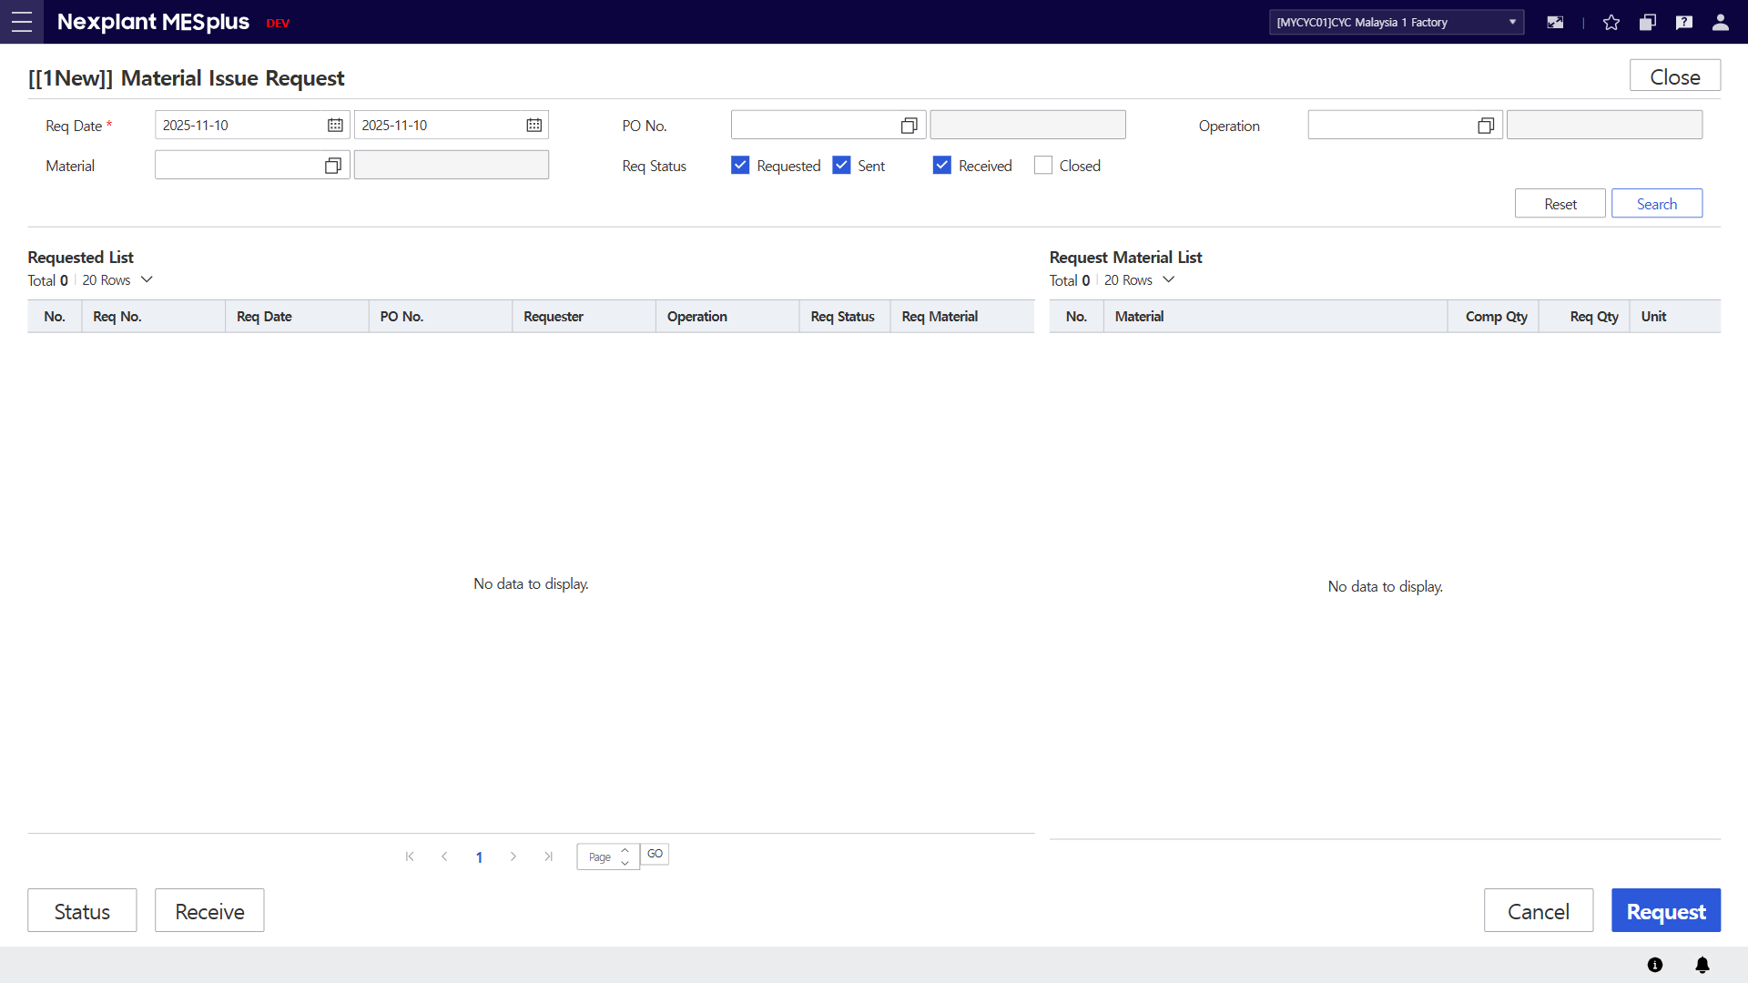
4. Material Issue Request (자재 불출 요청)
Main Menu | INV (Warehouse Management) | Sub Menu | INV Mat Mgt. (자재 관리) | UI Name | Material Issue Request | Program ID | 20210
UI | Description
 | 1. Enter the search conditions to retrieve requested list of materials. 2. Click the [Search] button to display the material list in the grid according to the search conditions. 3. Click the [Reset] button to clear all fields on the screen. 4. Requested material items will be displayed in the grid according to the search conditions. Select a requested item to display inventory LOTs in the request material list. 5. Inventory lots will be displayed in the grid according to the selected requested item. 6. Click [Request] button to create mater issue request and send create reservation I/F to ERP. Operation is required to be selected. 7. Click [Cancel] button to cancel issue request and send cancel reservation I/F to ERP. 8. Click [Status] button to redirect selected inventory lot to Material Status OI. 9. Click [Receive] button to redirect selected inventory lot to Material Receive OI. 10. Click the [Close] button to exit the OI.
10
1
3
2
4
5
8
9
7
6

Slide 7
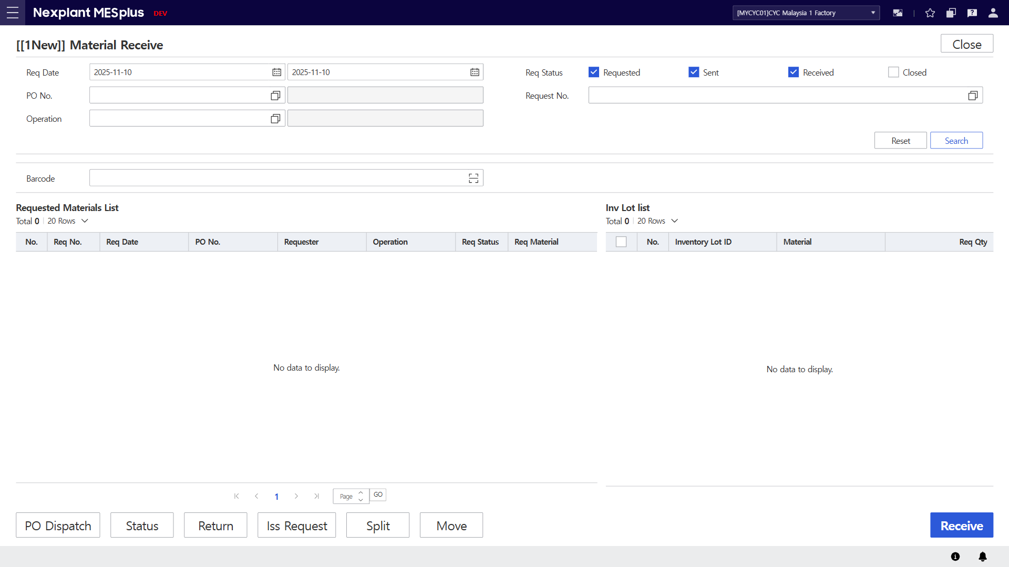
5. Material Receive
Main Menu | INV (Warehouse Management) | Sub Menu | INV Mat Mgt. (자재 관리) | UI Name | Material Receive | Program ID | 20235
UI | Description
 | 1. Enter the search conditions to retrieve requested list of materials. 2. Click the [Search] button to display the material list in the grid according to the search conditions. 3. Click the [Reset] button to clear all fields on the screen. 4. Requested material items will be displayed in the grid according to the search conditions. Select a requested item to display inventory LOTs in the grid on the right. 5. Inventory lots will be displayed in the grid according to the selected requested item. 6. Scan a barcode with camera and matching inventory lot will be auto checked in the inventory lot list. 7. Click [Receive] button to received checked inventory lots and send receive reservation I/F to ERP. 8. Click [PO Dispatch] button to redirect to PO Dispatch OI. 9. Click [Status] button to redirect to Material Status OI. 10. Click [Return] button to redirect to Material Return OI. 11. Click [Iss Request] button to redirect to Material Issue Request OI. 12. Click [Split] button to redirect to Material Split OI. 13. Click [Move] button to redirect to Material Move OI. 14. Click the [Close] button to exit the OI.
14
1
3
2
6
4
5
8
9
10
11
12
13
7

Slide 8
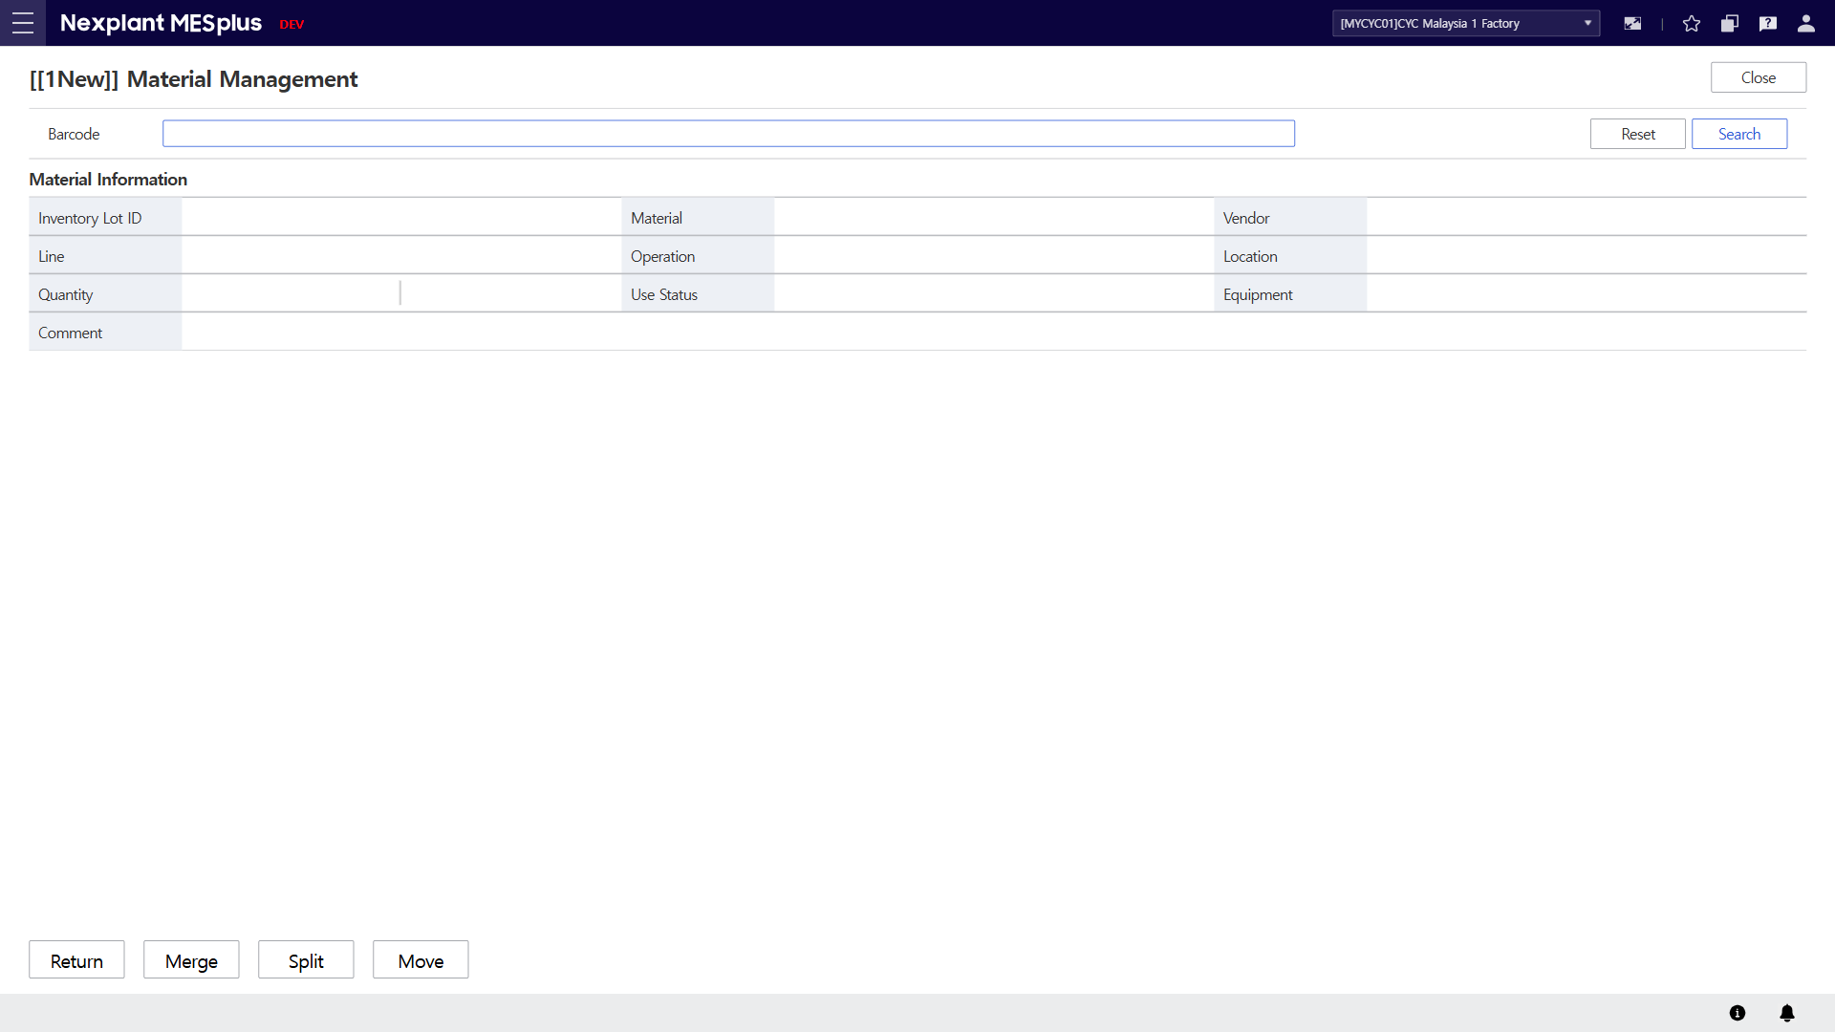
6. Material Management
Main Menu | INV (Warehouse Management) | Sub Menu | INV Mat Mgt. (자재 관리) | UI Name | Material Management | Program ID | 20275
UI | Description
 | 1. Scan or key-in a barcode to retrieve material information. 2. Click the [Search] button to display the material information in the grid according to barcode value. 3. Click the [Reset] button to clear all fields on the screen. 4. Material information will be displayed. 5. Click [Return] button to redirect to Material Return OI. 6. Click [Merge] button to redirect to Material Merge OI. 7. Click [Split] button to redirect to Material Split OI. 8. Click [Move] button to redirect to Material Move OI. 9. Click the [Close] button to exit the OI.
9
1
3
2
4
5
6
7
8

Slide 9
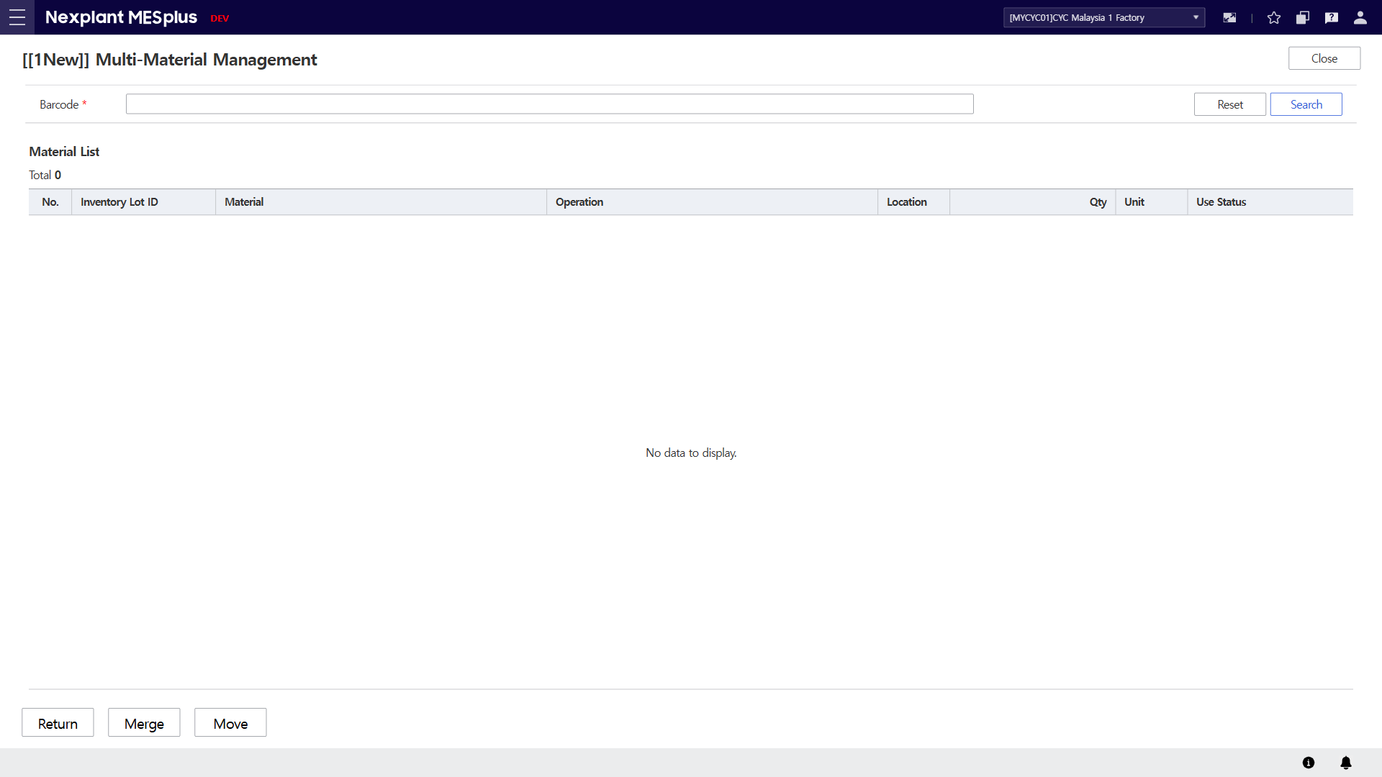
7. Multi-Material Management
Main Menu | INV (Warehouse Management) | Sub Menu | INV Mat Mgt. (자재 관리) | UI Name | Multi-Material Management | Program ID | 20276
UI | Description
 | 1. Scan or key-in a barcode to retrieve material information. 2. Click the [Search] button to display the material information in the grid according to barcode value. 3. Click the [Reset] button to clear all fields on the screen. 4. Material information will be displayed. 5. Click [Return] button to redirect to Material Return OI. 6. Click [Merge] button to redirect to Material Merge OI. 7. Click [Move] button to redirect to Material Move OI. 8. Click the [Close] button to exit the OI.
8
1
3
2
4
5
6
7

Slide 10
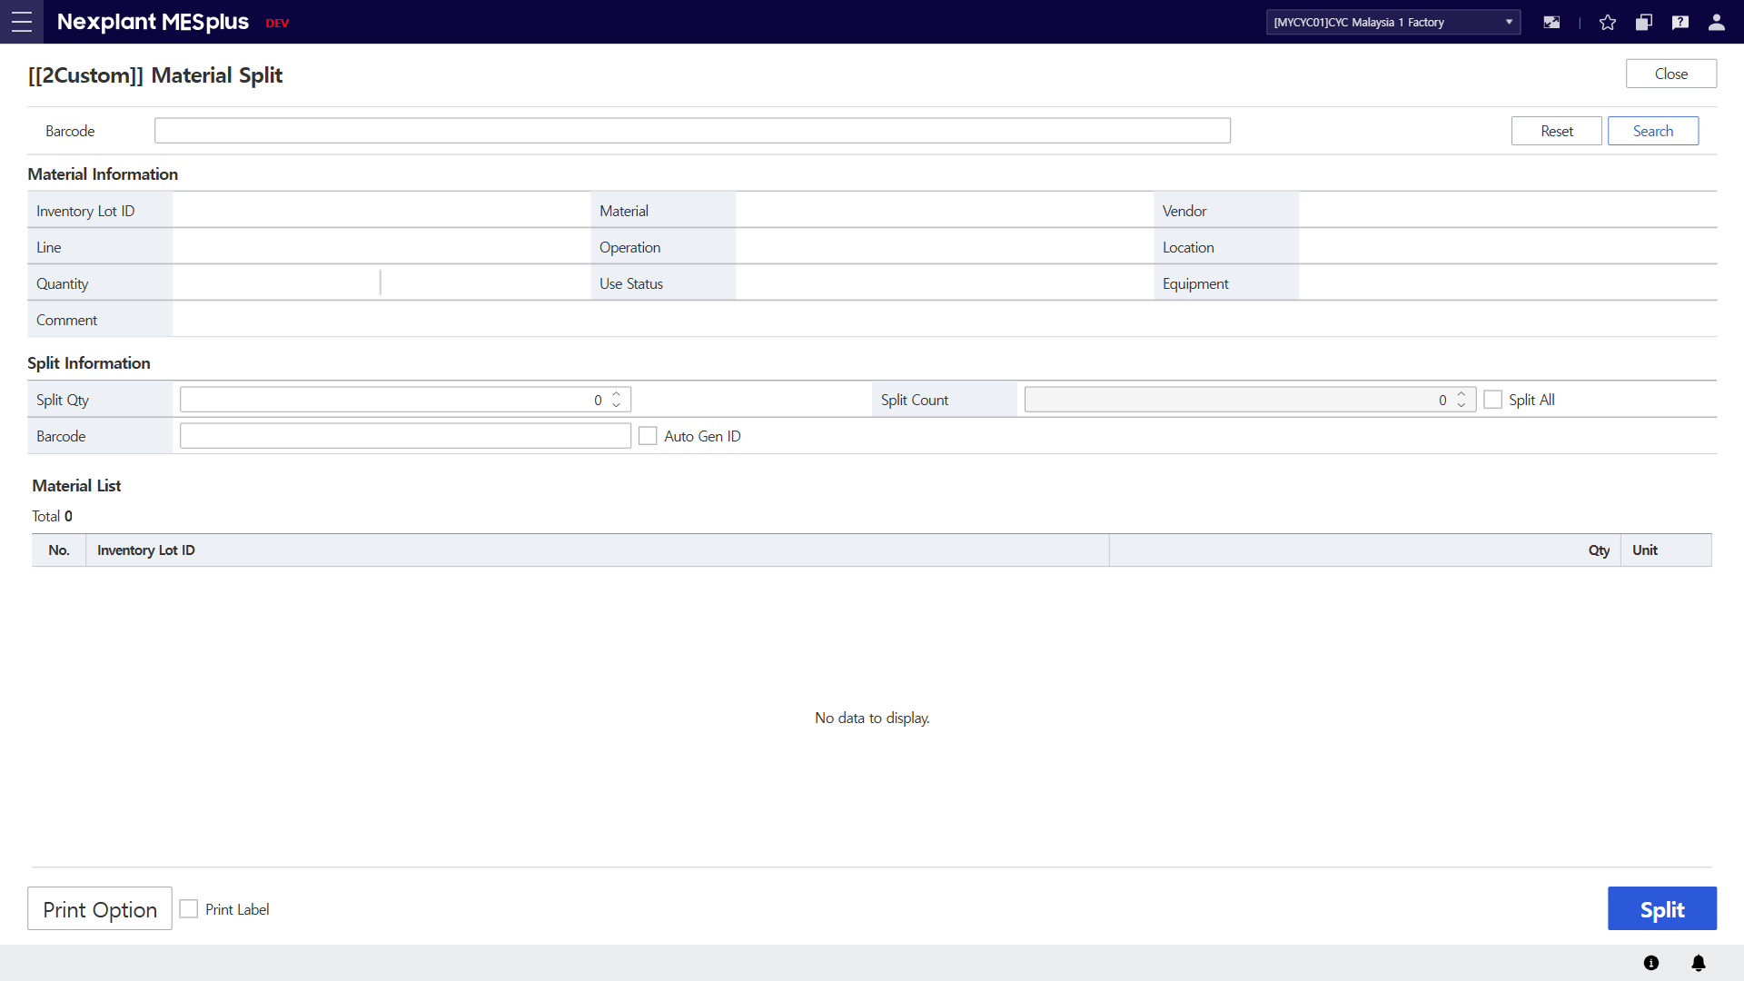
8. Material Split (자재 분할)
Main Menu | INV (Warehouse Management) | Sub Menu | INV Mat Mgt. (자재 관리) | UI Name | Material Split | Program ID | 20280
UI | Description
 | 1. Scan or key-in a barcode to retrieve material information. 2. Click the [Search] button to display the material information in the grid according to barcode value. 3. Click the [Reset] button to clear all fields on the screen. 4. Material information will be displayed. 5. Input split information. New barcode ID can be auto generated by system or key-in by user. Key-in barcode will be listed up in Material List. 6. Key-in barcode ID and information will be listed up in the grid. 7. Click [Split] button to split mother inventory lot into child inventory lots. 8. Click [Print Option] button to choose a printer. 9. Check [Print Label] checkbox to enable label printing/ 10. Click the [Close] button to exit the OI.
10
1
3
2
4
5
6
8
9
7

Slide 11
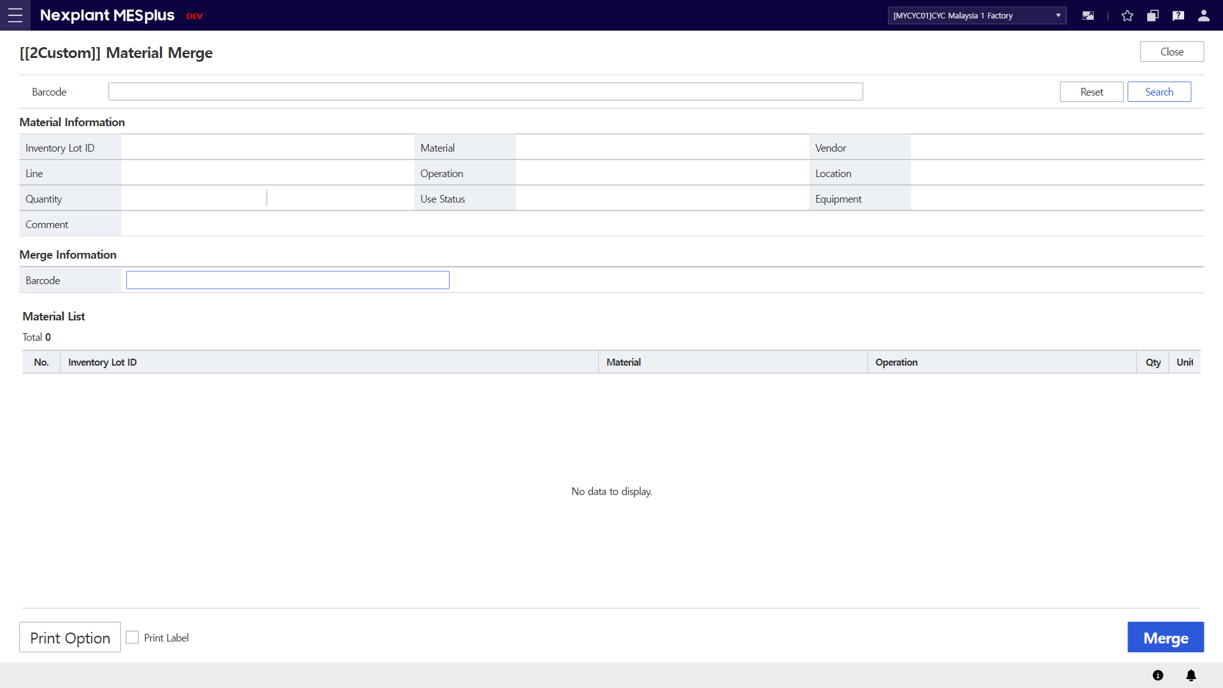
9. Material Merge (자재 병합)
Main Menu | INV (Warehouse Management) | Sub Menu | INV Mat Mgt. (자재 관리) | UI Name | Material Merge | Program ID | 20300
UI | Description
 | 1. Scan or key-in a barcode to retrieve material information. 2. Click the [Search] button to display the material information in the grid according to barcode value. 3. Click the [Reset] button to clear all fields on the screen. 4. Material information will be displayed. 5. Scan or key-in a barcode. 6. Inventory lots from #5 will be listed in the material list. 7. If mother inventory lot is not scanned in #1, the first inventory lot in Material List will be the mother lot. Click [Merge] button to merge lots. 8. Click [Print Option] button to choose a printer. 9. Check [Print Label] checkbox to enable label printing/ 10. Click the [Close] button to exit the OI.
10
1
3
2
4
5
6
8
9
7

Slide 12
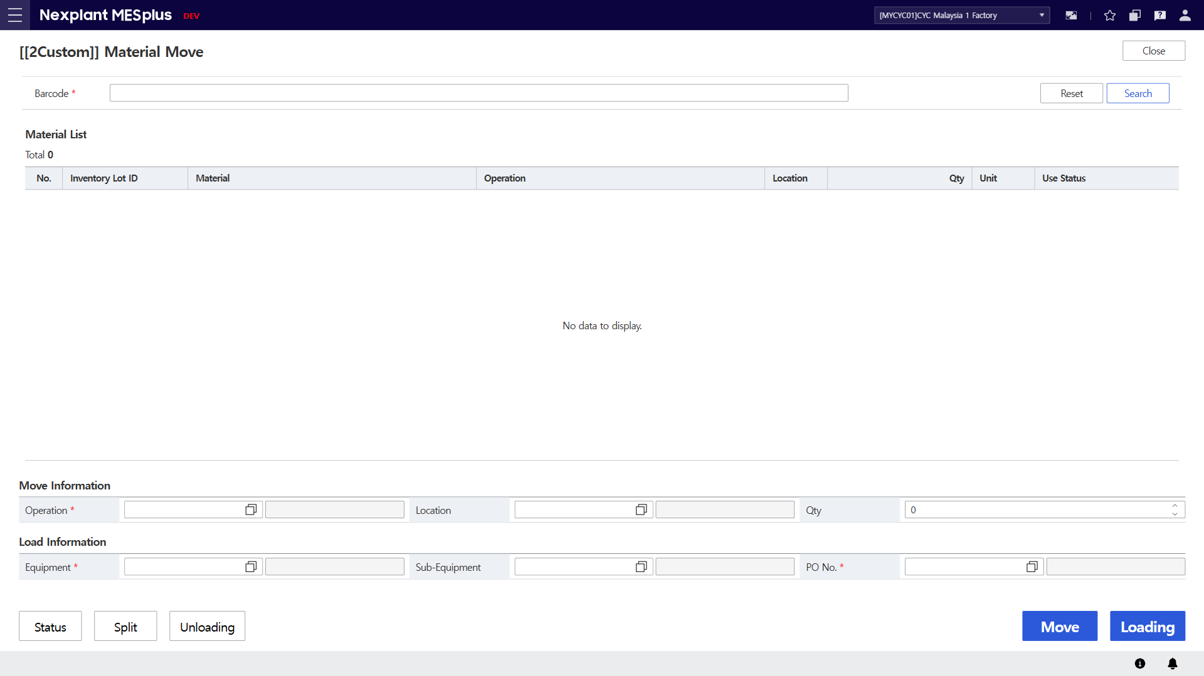
10. Material Move (자재 이동)
Main Menu | INV (Warehouse Management) | Sub Menu | INV Mat Mgt. (자재 관리) | UI Name | Material Move | Program ID | 20310
UI | Description
 | 1. Scan or key-in a barcode to retrieve material information. 2. Click the [Search] button to display the material information in the grid according to barcode value. 3. Click the [Reset] button to clear all fields on the screen. 4. Material information of scanned barcode will be listed up in the material list. 5. Select move information. When selecting move information, Load information fields and [Loading] button will be disabled. 6. Select load information. When selecting load information, Move information fields and [Move] button will be disabled. 7. Click [Loading] button to load a lot/lots according to load information. 8. Click [Move] button to move a lot/lots according to move information. 9. Click [Status] button to redirect to Material Status OI. 10. Click [Split] button to redirect to Material Split OI. 11. Click [Unloading] button to redirect to Material Unload OI. 12. Click the [Close] button to exit the OI.
12
1
3
2
4
5
6
9
10
11
8
7

Slide 13
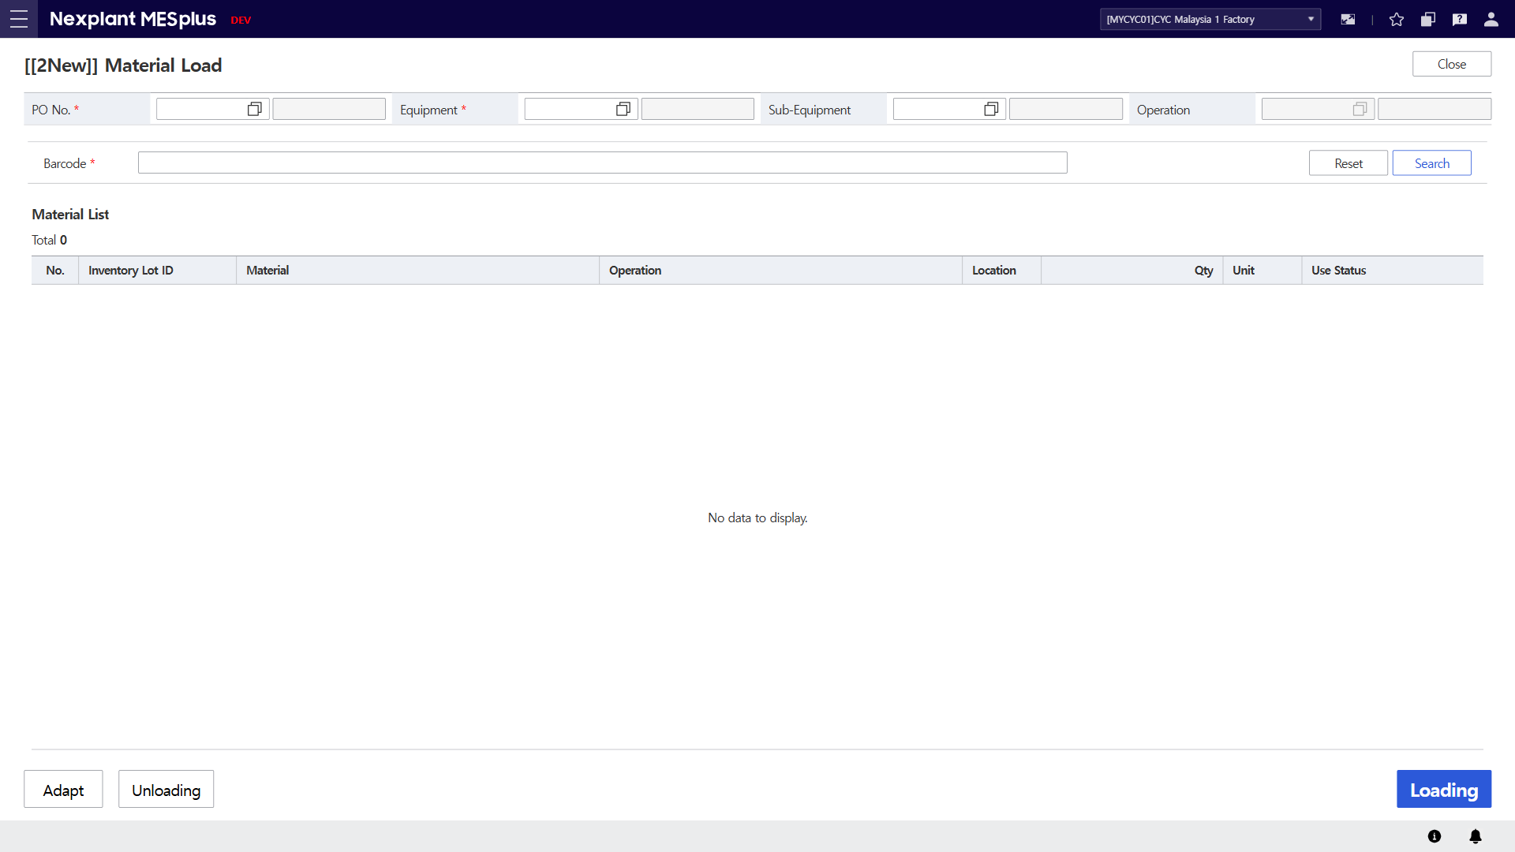
11. Material Load
Main Menu | INV (Warehouse Management) | Sub Menu | INV Mat Mgt. (자재 관리) | UI Name | Material Load | Program ID | 20315
UI | Description
 | 1. Select material loading information. 2. Scan or key-in a barcode to load. 3. Click the [Search] button to display the material information in the grid according to barcode value. 4. Click the [Reset] button to clear all fields on the screen. 5. Material information of scanned barcode will be listed up in the material list. 6. Click [Loading] button to load a lot/lots according to load information. 7. Click [Adapt] button to redirect to Material Status OI. 8. Click [Unloading] button to redirect to Material Split OI. 9. Click the [Close] button to exit the OI.
9
1
2
4
3
5
7
8
6

Slide 14
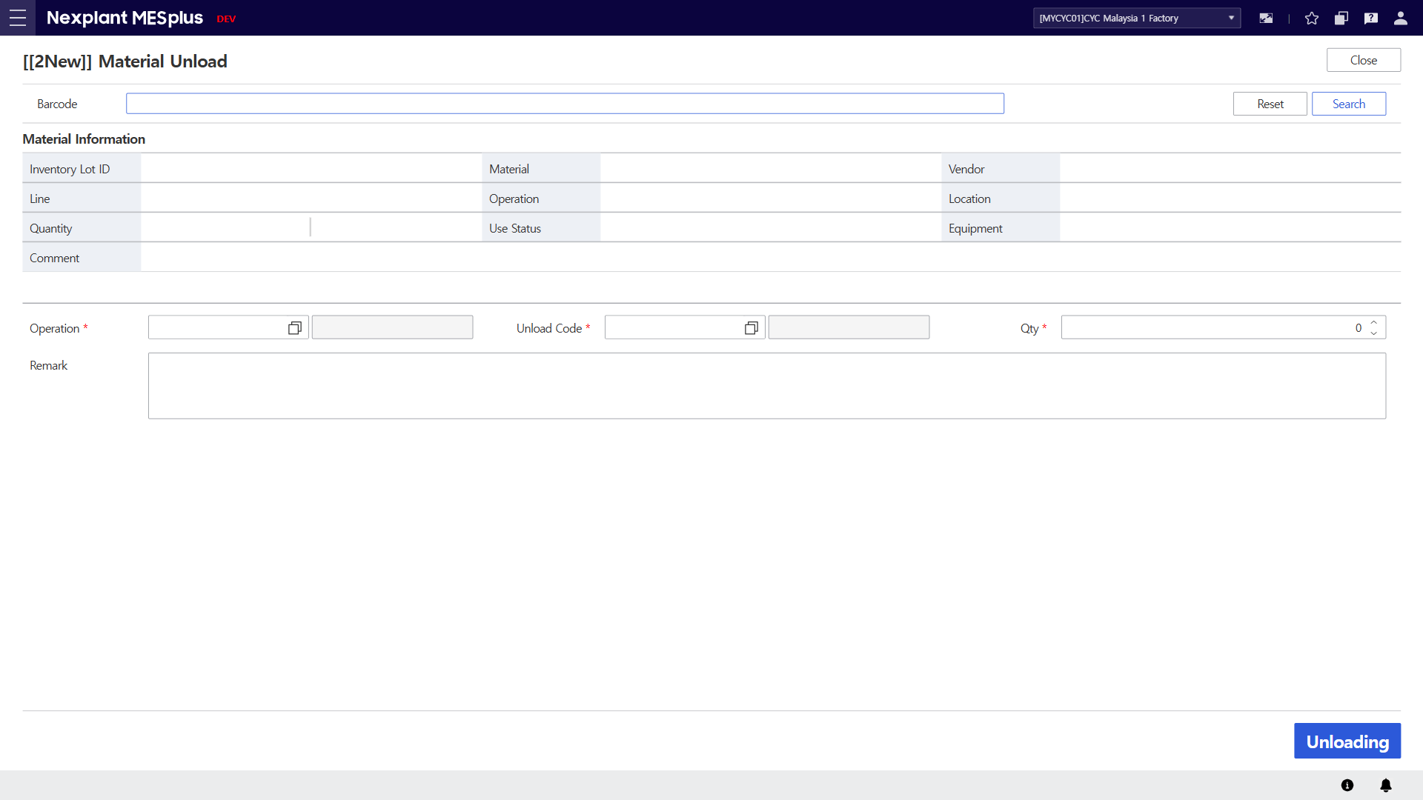
12. Material Unload
Main Menu | INV (Warehouse Management) | Sub Menu | INV Mat Mgt. (자재 관리) | UI Name | Material Unload | Program ID | 20317
UI | Description
 | 1. Scan or key-in a barcode to load. 2. Click the [Search] button to retrieve material information 3. Click the [Reset] button to clear all fields on the screen. 4. Material information of scanned barcode will be displayed. 5. Select material unload information. 6. Click [Unloading] button to unload a lot. 7. Click the [Close] button to exit the OI.
7
1
3
2
4
5
6

Slide 15
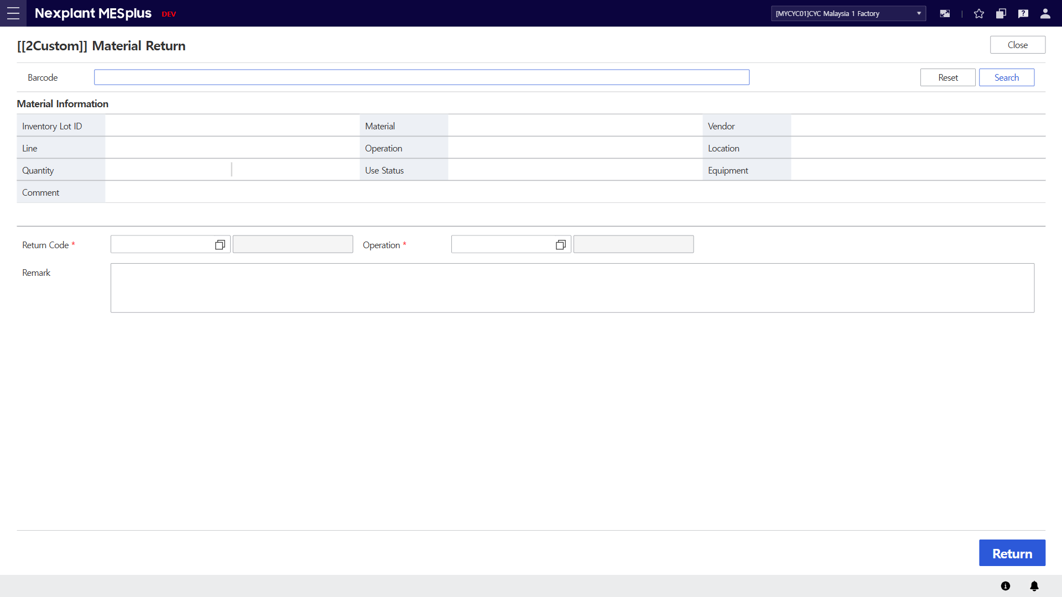
13. Material Return (자재 반납)
Main Menu | INV (Warehouse Management) | Sub Menu | INV Mat Mgt. (자재 관리) | UI Name | Material Return | Program ID | 20320
UI | Description
 | 1. Scan or key-in a barcode to return. 2. Click the [Search] button to retrieve material information 3. Click the [Reset] button to clear all fields on the screen. 4. Material information of scanned barcode will be displayed. 5. Select material return information. 6. Click [Return] button to return a lot. 7. Click the [Close] button to exit the OI.
7
1
3
2
4
5
6

Slide 16
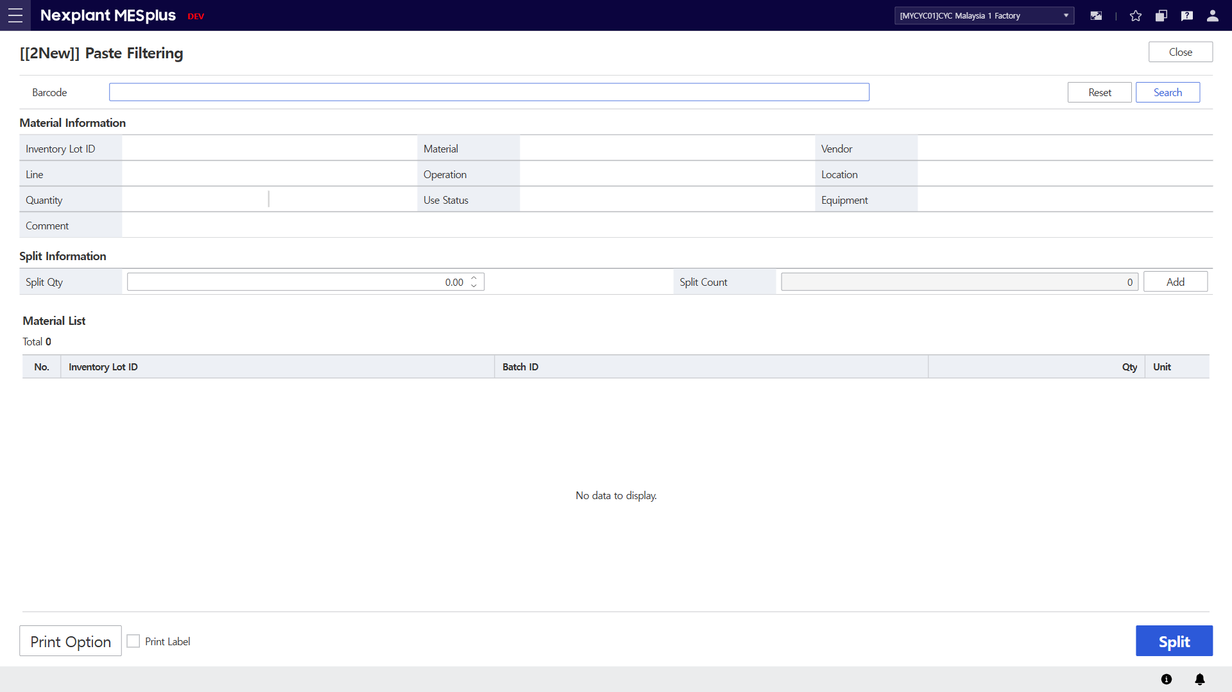
14. Paste Filtering
Main Menu | INV (Warehouse Management) | Sub Menu | INV Chk Mgt. (재고 관리) | UI Name | Paste Filtering | Program ID | 20403
UI | Description
 | 1. Scan or key-in a barcode to split paste material. 2. Click the [Search] button to retrieve material information 3. Click the [Reset] button to clear all fields on the screen. 4. Material information of scanned barcode will be displayed. 5. Input split quantity of paste. 6. When clicking [Add] button, inventory lot ID will be auto generated by system and listed up in the grid. 7. List of paste inventory lots will be displayed. 8. Click [Split] button to split inventory lots in the grid from the mother lot. 9. Click [Print Option] button to choose a printer. 10. Check [Print Label] checkbox to enable label printing. 11. Click the [Close] button to exit the OI.
11
1
3
2
4
5
6
7
9
10
8

Slide 17
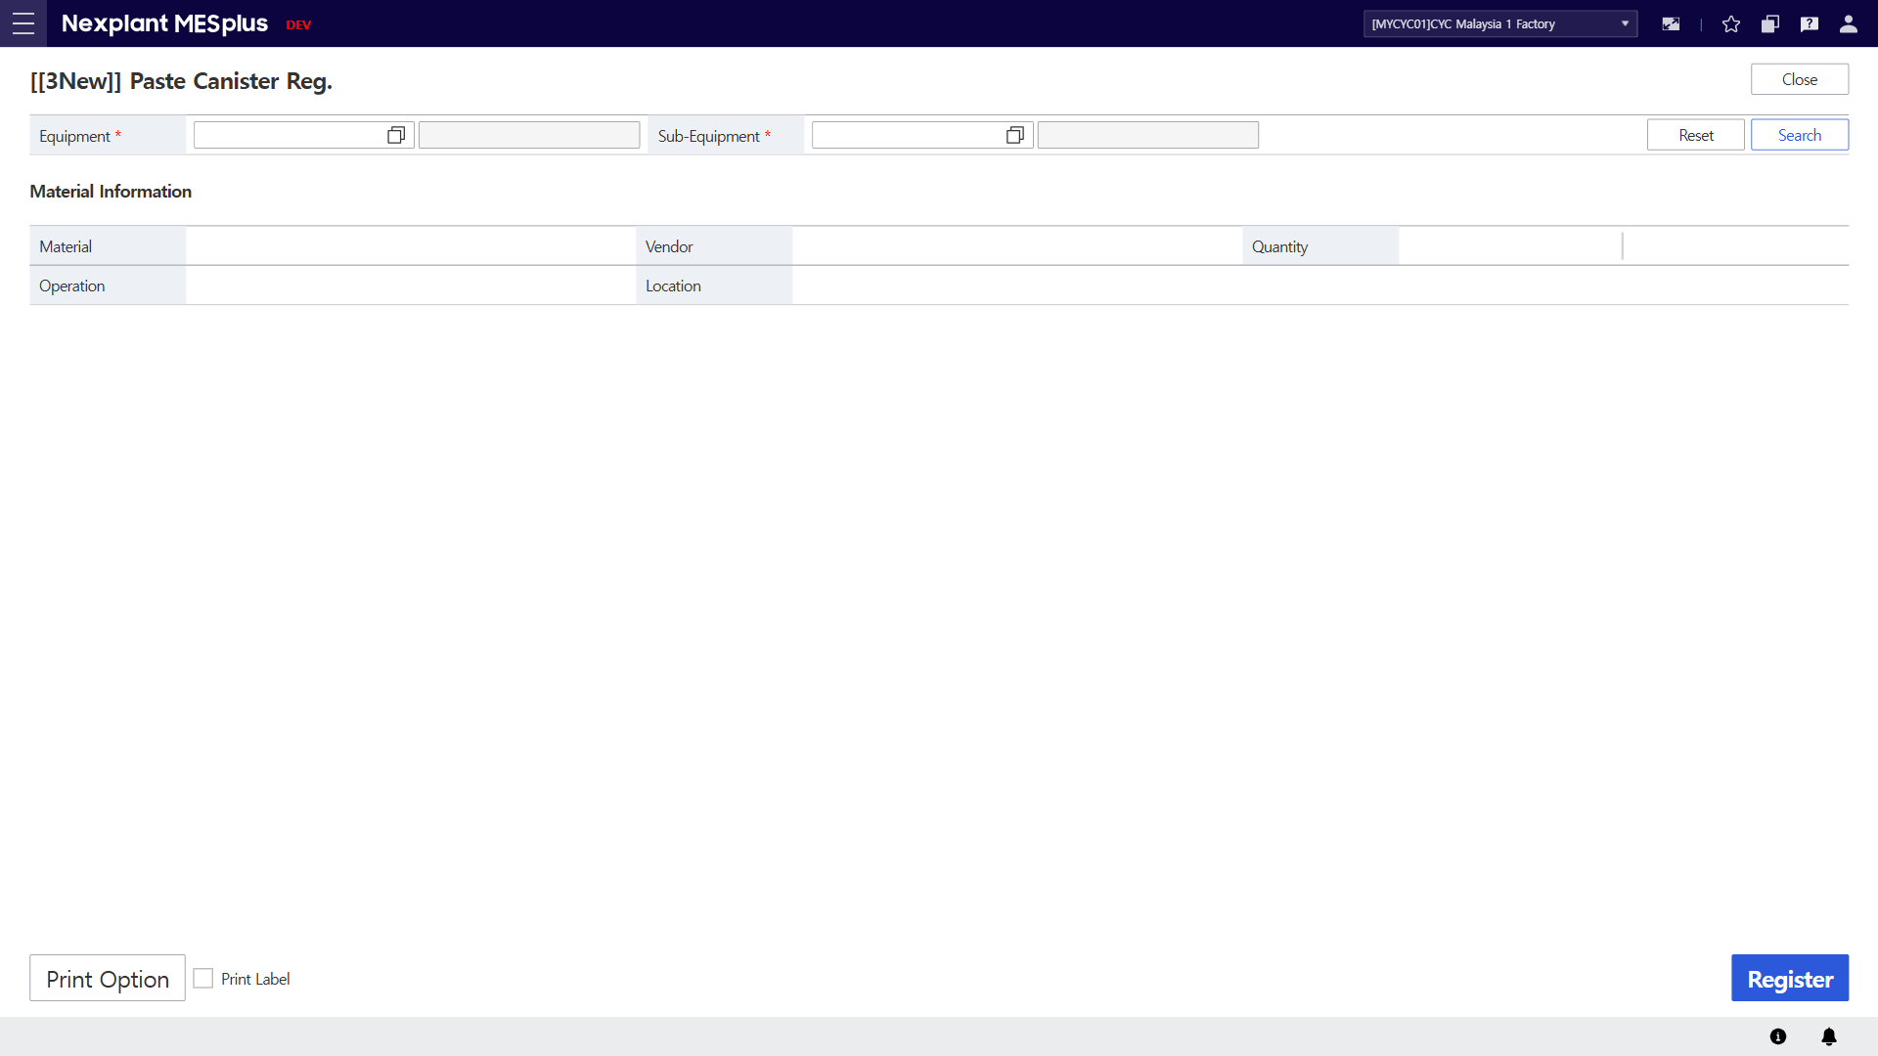
15. Paste Canister Reg.
Main Menu | INV (Warehouse Management) | Sub Menu | INV Chk Mgt. (재고 관리) | UI Name | Paste Canister Reg. | Program ID | 20405
UI | Description
 | 1. Select Equipment and Sub-Equipment to retrieve material information of a loaded paste material. 2. Click the [Search] button to retrieve material information 3. Click the [Reset] button to clear all fields on the screen. 4. Material information of the loaded paste material will be displayed. 5. Click the [Register] button to create an paste material with zero quantity. 6. Click [Print Option] button to choose a printer. 7. Check [Print Label] checkbox to enable label printing. 8. Click the [Close] button to exit the OI.
8
1
3
2
4
6
7
5

Slide 18
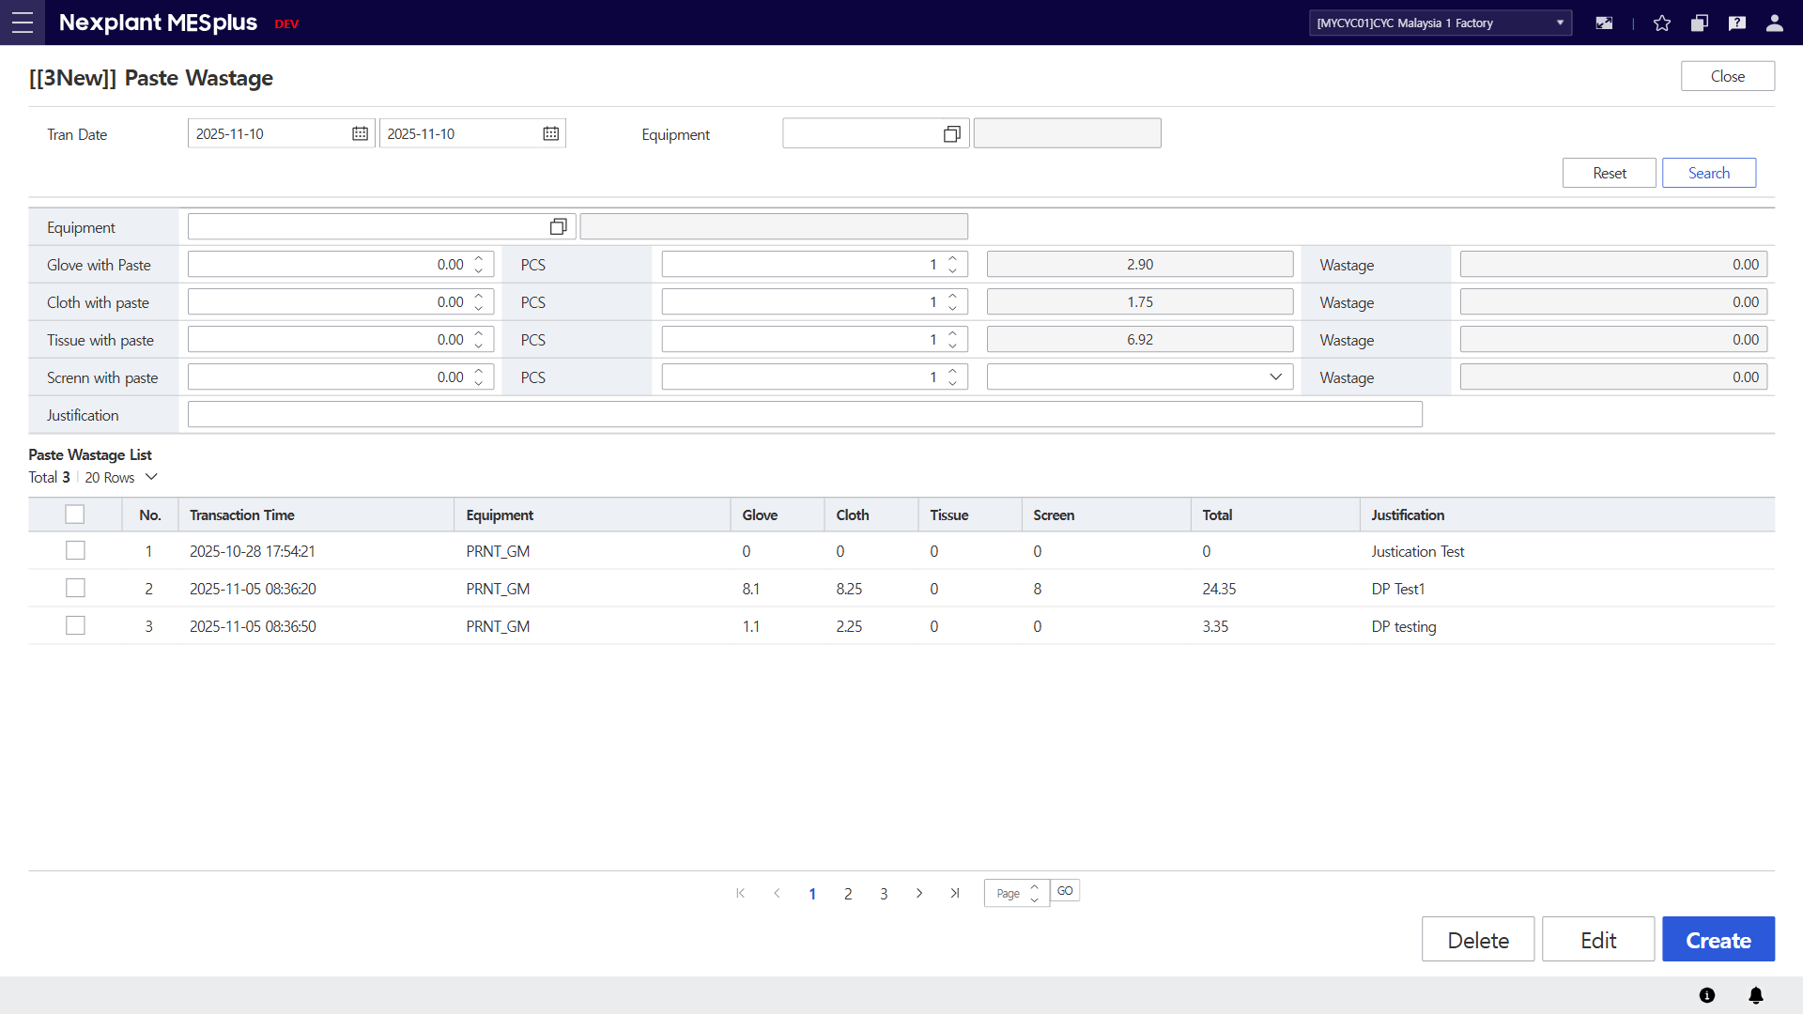
16. Paste Wastage
Main Menu | INV (Warehouse Management) | Sub Menu | INV Chk Mgt. (재고 관리) | UI Name | Paste Wastage | Program ID | 20407
UI | Description
 | 1. Enter the search conditions to retrieve paste wastage list. 2. Click the [Search] button to retrieve material information 3. Click the [Reset] button to clear all fields on the screen. 4. Input paste wastage information to register paste wastage. 5. Click the [Create] button to create paste wastage according to the input information. 6. List of paste wastage will be displayed. 7. Click the [Edit] button to update Justification column in the grid. 8. Click the [Delete] button to delete checked item from the grid. 9. Click the [Close] button to exit the OI.
9
1
3
2
4
6
8
7
5

Slide 19
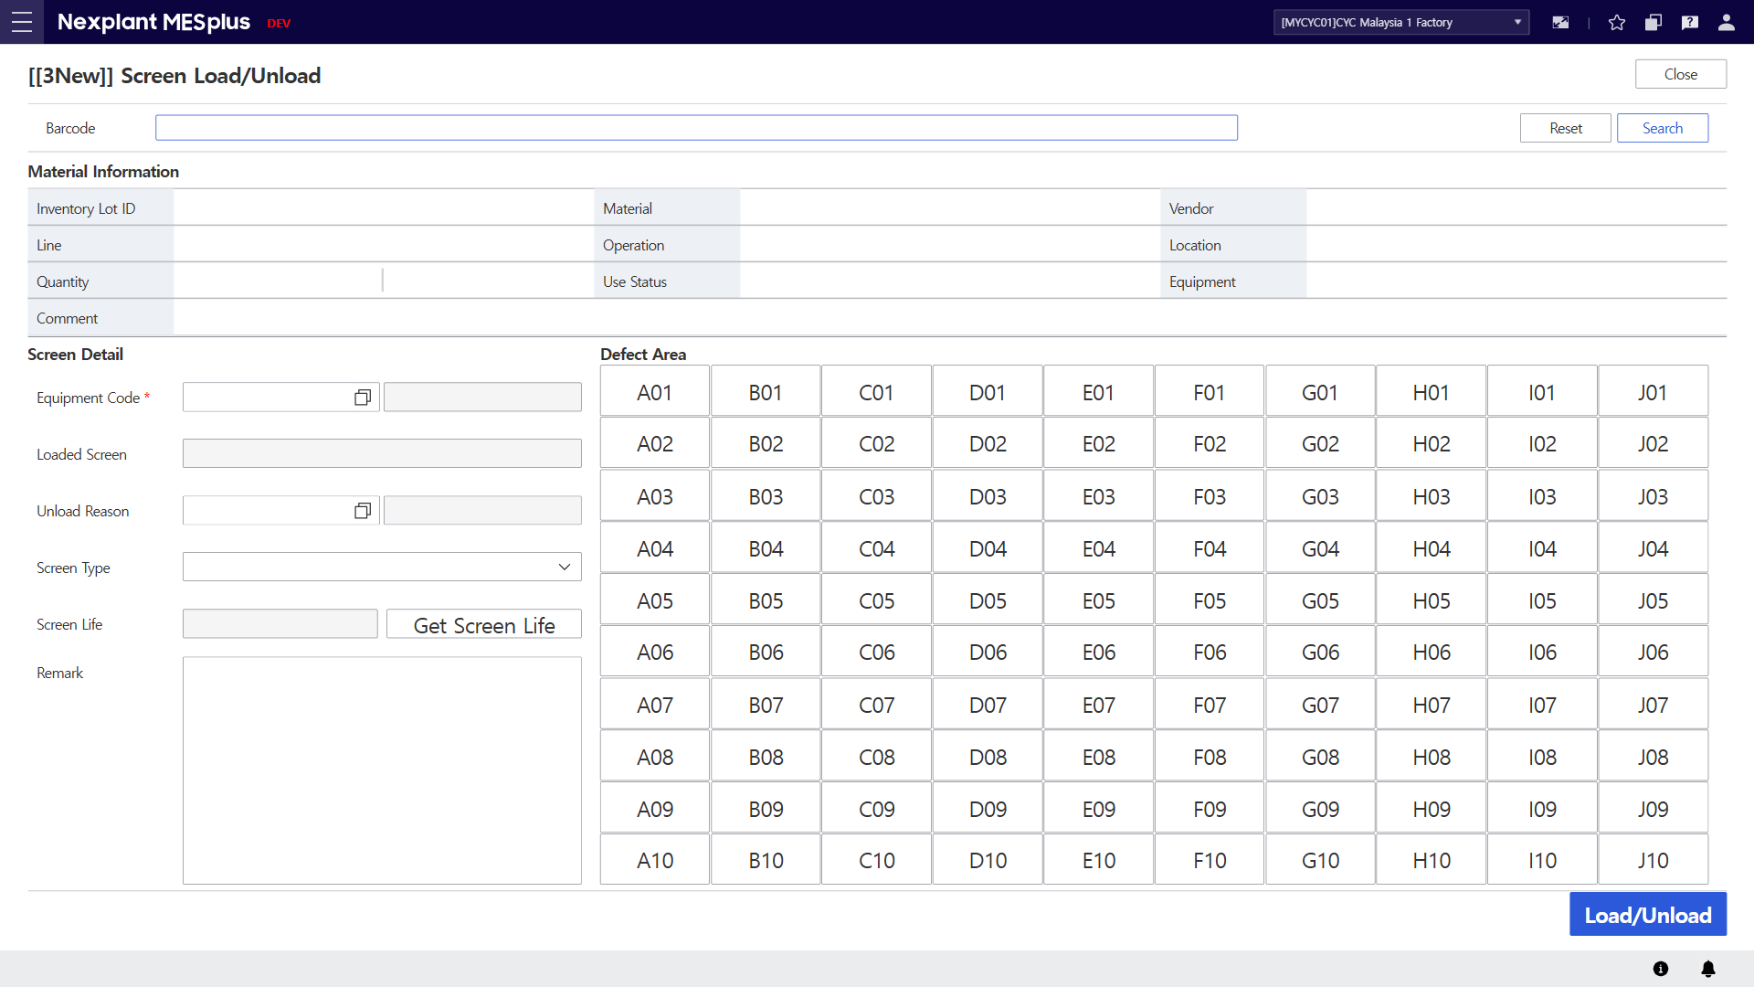
17. Screen Load/Unload
Main Menu | INV (Warehouse Management) | Sub Menu | INV Mat Mgt. (자재 관리) | UI Name | Screen Load/Unload | Program ID | 20417
UI | Description
 | 1. Scan a new screen to be loaded. 2. Click the [Search] button to retrieve material information 3. Click the [Reset] button to clear all fields on the screen. 4. Material information of the scanned screen will be displayed. 5. Select a target equipment to load a new screen with unload reason code, screen type, screen life and remark. 6. Select defect area of loaded screen to be unloaded. 7. Click the [Load/Unload] button to unload a loaded screen and to load a new screen. 8. Click the [Close] button to exit the OI.
8
1
3
2
4
5
6
7

Slide 20
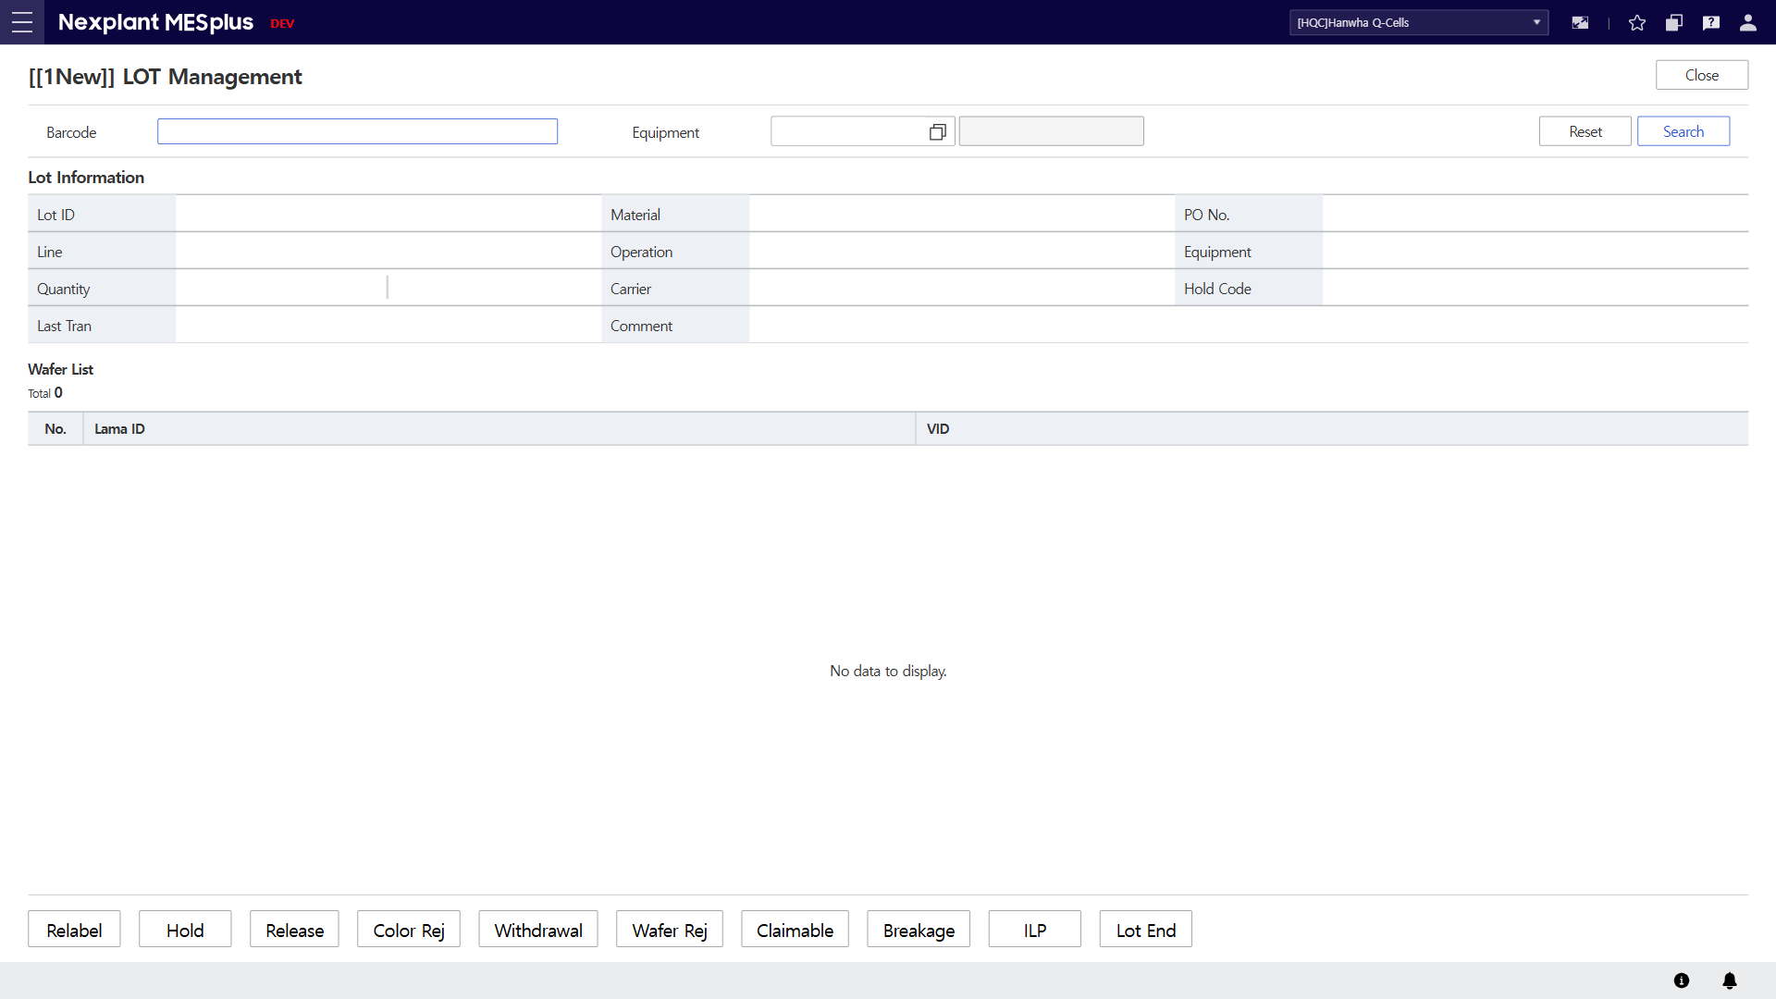
18. LOT Management
Main Menu | WIP (Production Management) | Sub Menu | LOT Mgt. (LOT 관리) | UI Name | LOT Management
UI | Description
 | 1) Enter the search conditions to retrieve LOT information and LAMA list. 2) Click the [Search] button to display the requested list in the grid according to the search conditions. 3) Click the [Reset] button to clear all fields on the screen. 4) LOT information will be displayed according to the search conditions. 5) LAMA list will be displayed according to the search conditions. 6) Click the button at the bottom to navigate to the corresponding menu. 7) Click the [Close] button to exit the OI.
7
1
3
2
4
5
6

Slide 21
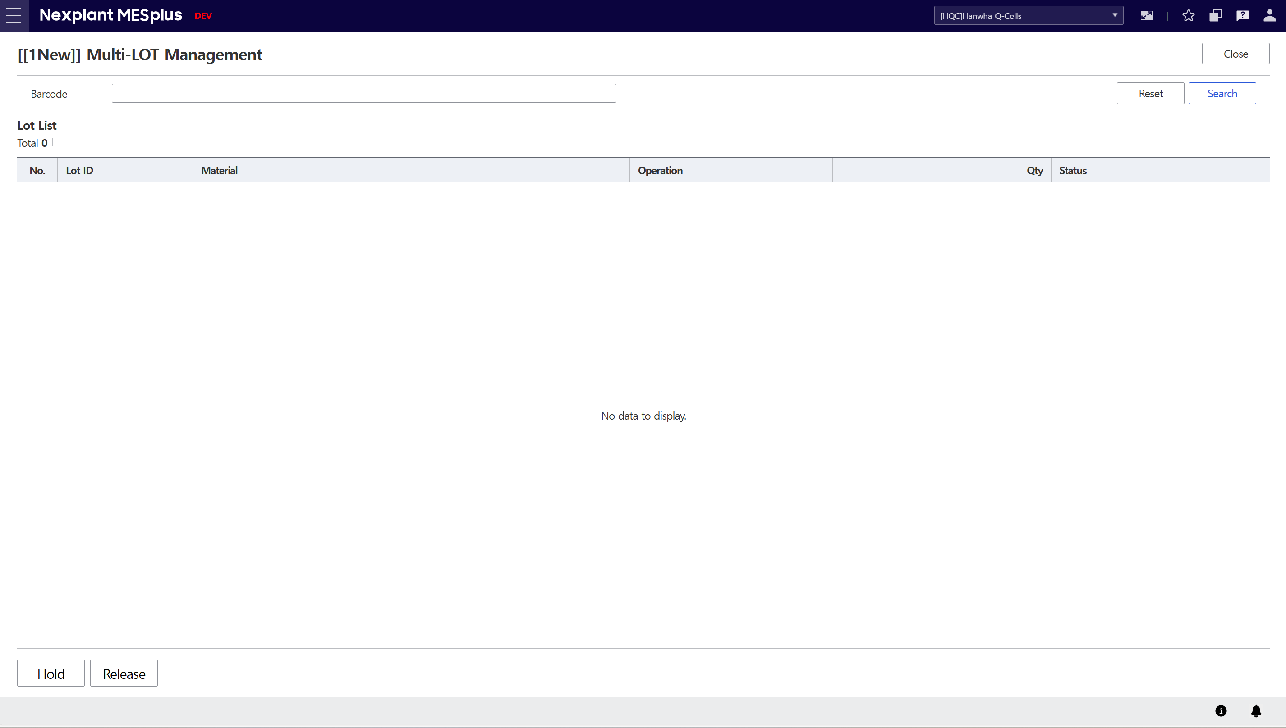
19. Multi-LOT Management
Main Menu | WIP (Production Management) | Sub Menu | LOT Mgt. (LOT 관리) | UI Name | Multi-LOT Management
UI | Description
 | 1) Enter the search conditions to retrieve LOT information. 2) Click the [Search] button to display the requested list in the grid according to the search conditions. 3) Click the [Reset] button to clear all fields on the screen. 4) LOT information will be displayed in the grid. 5) Click the button at the bottom to navigate to the corresponding menu. 6) Click the [Close] button to exit the OI.
6
1
3
2
4
5

Slide 22
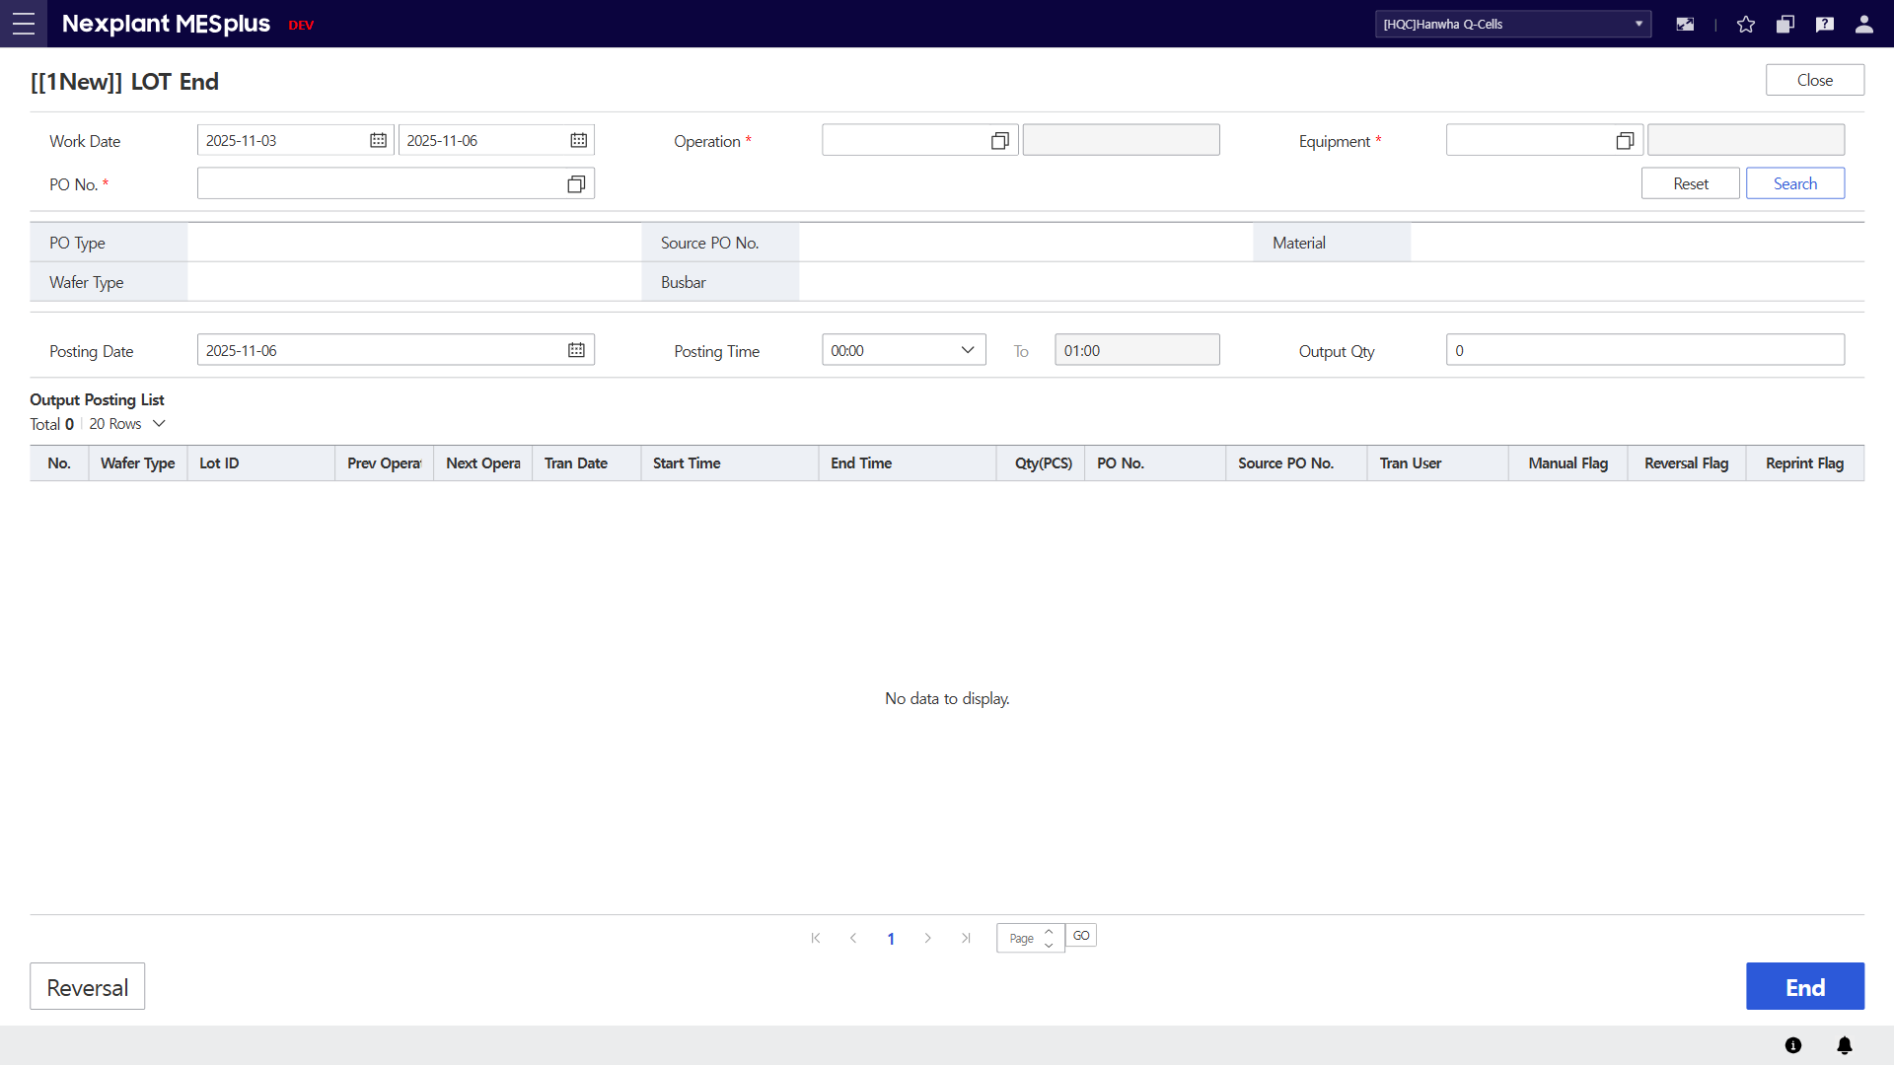
20. LOT End (LOT 작업 종료)
Main Menu | WIP (Production Management) | Sub Menu | LOT Mgt. (LOT 관리) | UI Name | LOT End
UI | Description
 | 1) Enter the search conditions to retrieve LOT information. 2) Click the [Search] button to display the requested list in the grid according to the search conditions. 3) Click the [Reset] button to clear all fields on the screen. 4) Information of the selected PO will be displayed. 5) Enter the information to process [LOT END] for the selected PO. 6) Click the [END] button to trigger the LOT END event with the entered information. 7) The Posting list will be displayed in the grid, including details. 8) Click the [Reversal] button to navigate to the Reversal screen for the selected LOT. 9) Click the [Close] button to exit the OI.
9
1
3
2
4
5
7
8
6

Slide 23
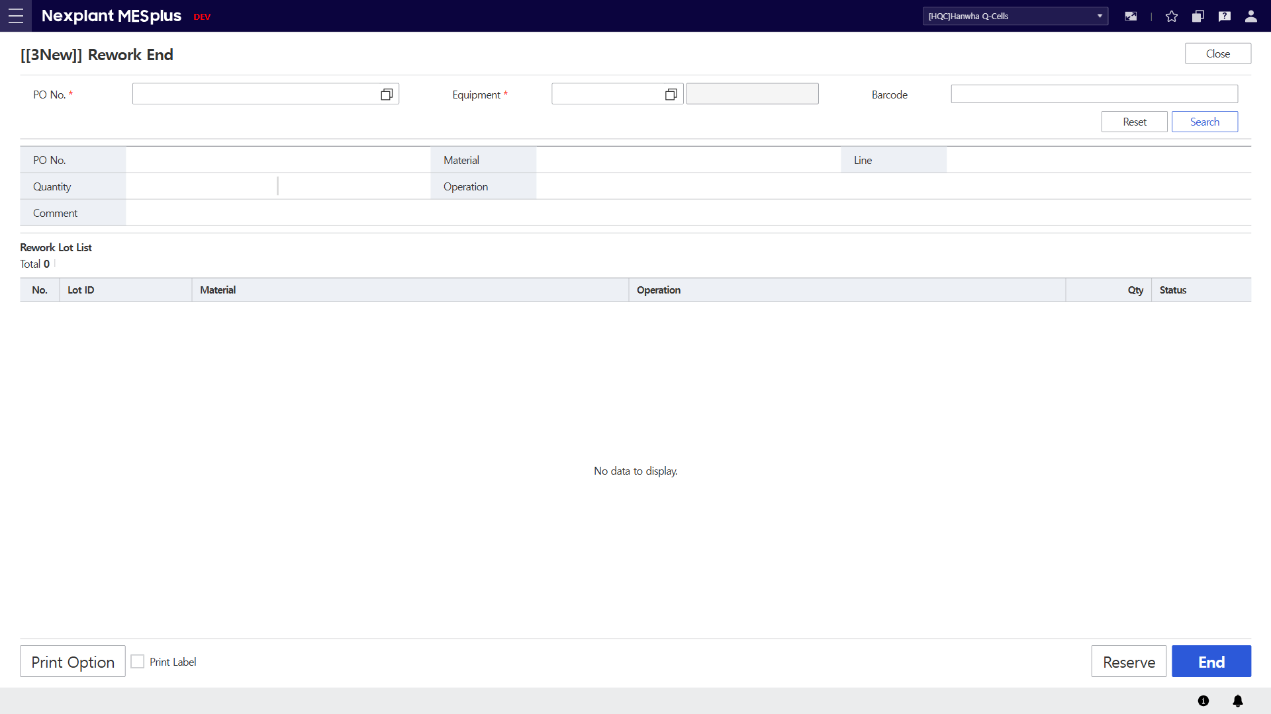
21. Rework End
Main Menu | WIP (Production Management) | Sub Menu | LOT Mgt. (LOT 관리) | UI Name | Rework End
UI | Description
 | 1) Enter the search conditions to retrieve LOT information. 2) Click the [Search] button to display the requested list in the grid according to the search conditions. 3) Click the [Reset] button to clear all fields on the screen. 4) Information of the selected LOT will be displayed. 5) LOT information will be displayed in the grid. 6) Click the [End] button to perform the Rework End process. 7) Click the [Reserve] button to reserve the selected LOT for the specified equipment. When the equipment is selected, the reserved LOTs will be displayed. 8) Click the [Print Option] button to select the printer for label printing. Check the checkbox to print the label when performing the Judge process. 9) Click the [Close] button to exit the OI.
9
1
3
2
4
5
8
7
6

Slide 24
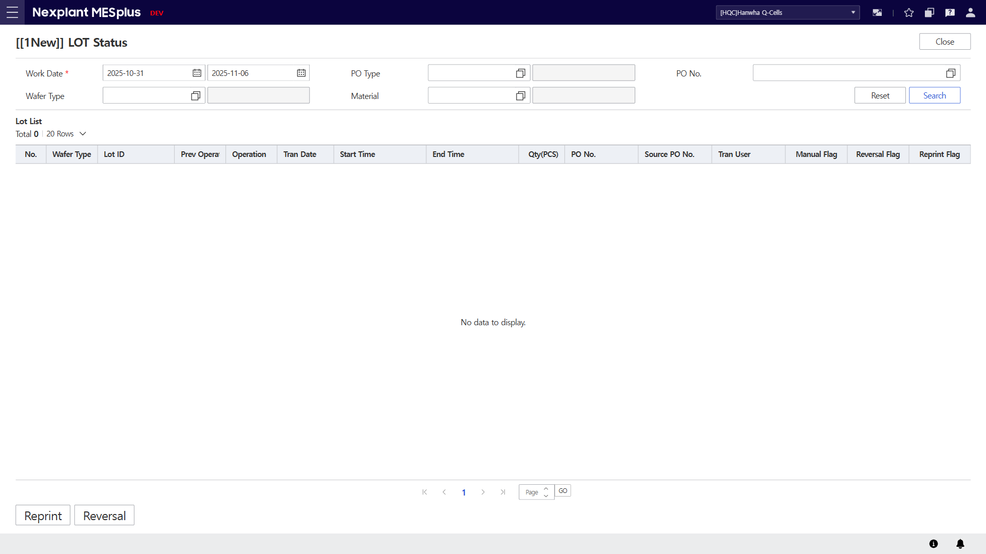
22. LOT Status
Main Menu | WIP (Production Management) | Sub Menu | LOT Mgt. (LOT 관리) | UI Name | LOT Status
UI | Description
 | 1) Enter the search conditions to retrieve LOT information. 2) Click the [Search] button to display the requested list in the grid according to the search conditions. 3) Click the [Reset] button to clear all fields on the screen. 4) LOT information will be displayed in the grid. 5) Click the [Reprint] button to navigate to the Reprint screen for the selected LOT. 6) Click the [Reversal] button to navigate to the Reversal screen for the selected LOT. 7) Click the [Close] button to exit the OI.
7
1
3
2
4
5
6

Slide 25

23. LOT Reversal
Main Menu | WIP (Production Management) | Sub Menu | LOT Mgt. (LOT 관리) | UI Name | LOT Reversal
UI | Description
 | 1) Enter the search conditions to retrieve LOT information. 2) Click the [Search] button to display the requested list in the grid according to the search conditions. 3) Click the [Reset] button to clear all fields on the screen. 4) LOT information will be displayed in the grid. 5) Enter the Reason Code and Remark to perform the Reversal process. 6) Click the [Reversal] button to perform the Reversal process for the selected LOT. 7) Click the [Close] button to exit the OI.
7
1
3
2
4
5
6

Slide 26
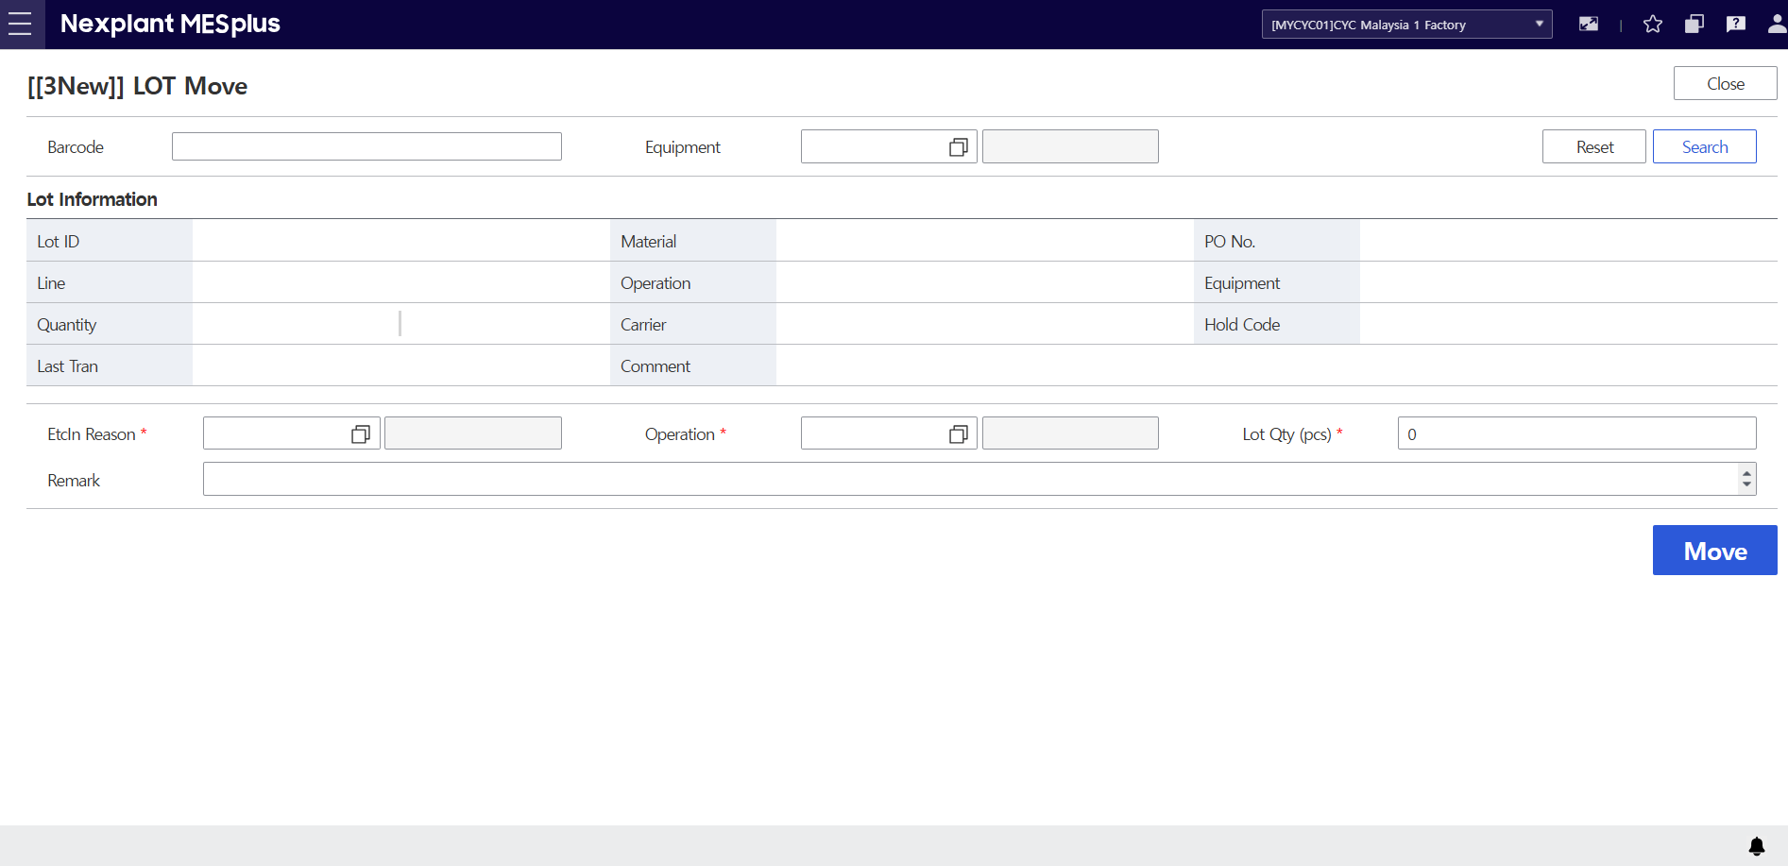
24. LOT Move (LOT 이동)
Main Menu | WIP (Production Management) | Sub Menu | LOT Mgt. (LOT 관리) | UI Name | LOT Move | Program ID | 20740
UI | Description
 | 1. Enter the barcode to retrieve Lot information. 2. Click the [Search] button to display the Lot information according to the search conditions. 3. Click the [Reset] button to clear all fields on the screen. 4. Lot information will be displayed according to the search conditions. 5. Enter the information for lot Moving. 6. Click the [Move] button to move the Lot. *The Lot quantity changes according to the entered Lot Qty. 7. Click the [Close] button to exit the OI.
7
1
3
2
4
5
6

Slide 27
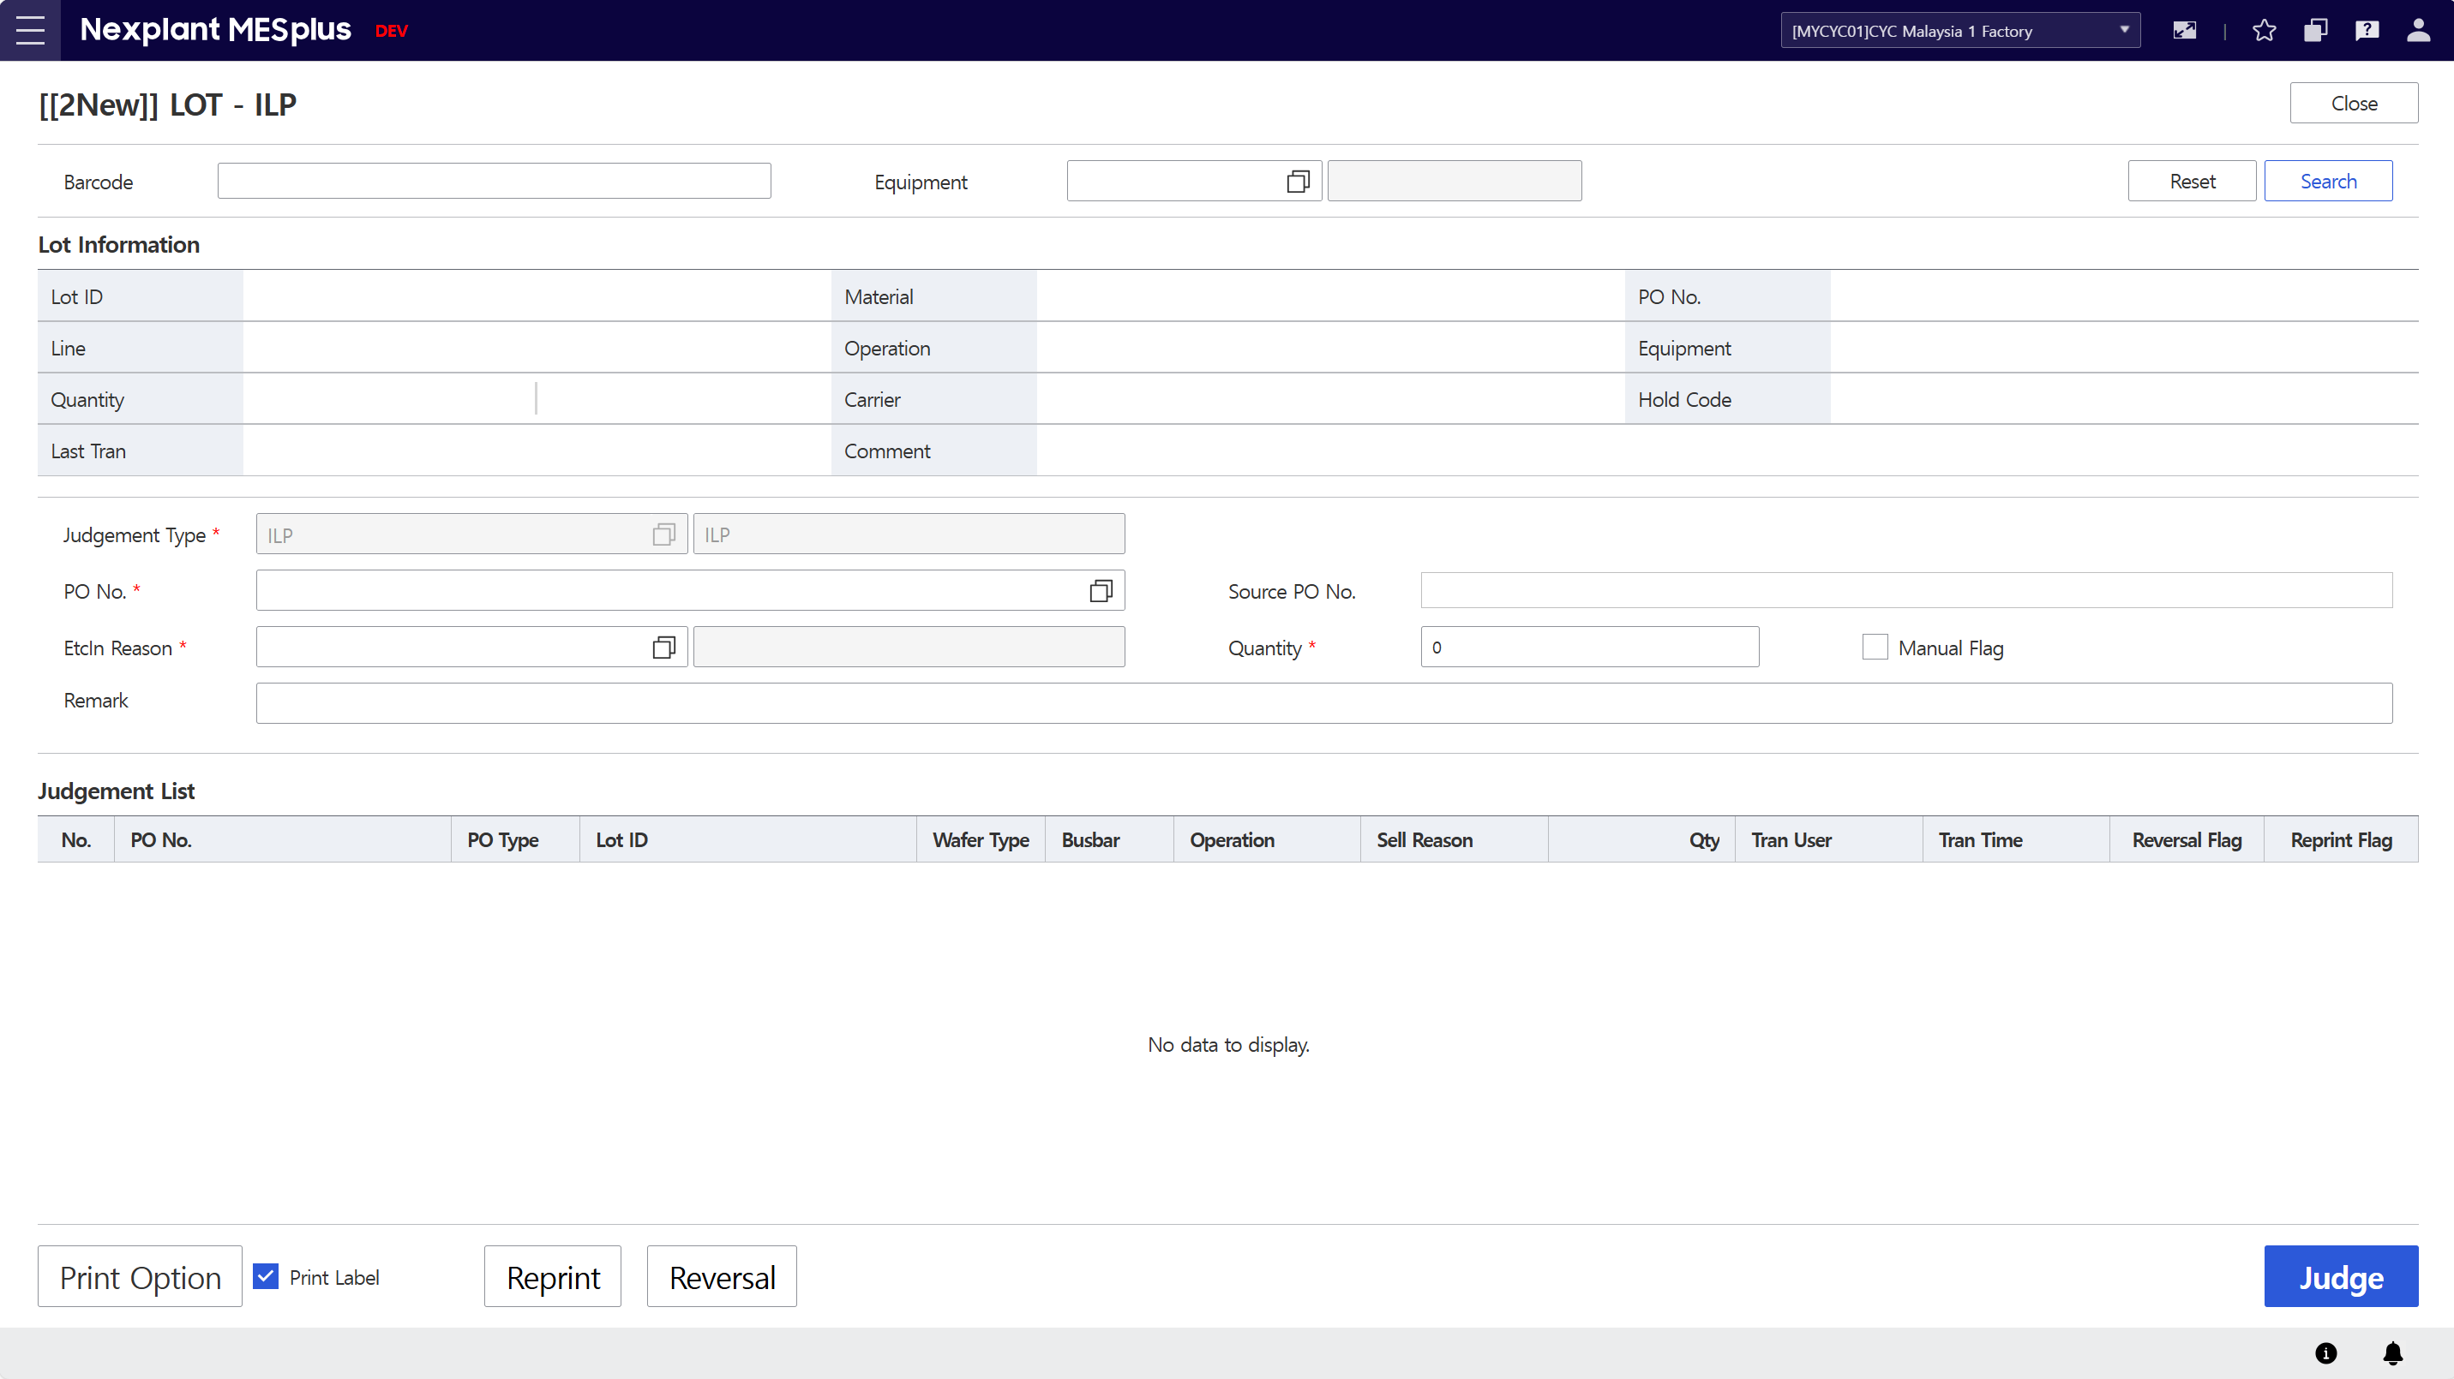
25. Lot Judgement (LOT 재작업 판정)
Main Menu | WIP (Production Management) | Sub Menu | LOT Mgt. (LOT 관리) | UI Name | Lot Judgement
UI | Description
 | 1) Enter the search conditions to retrieve LOT information. 2) Click the [Search] button to display the requested list in the grid according to the search conditions. 3) Click the [Reset] button to clear all fields on the screen. 4) LOT information will be displayed in the grid. 5) Enter the information to perform the judgement process. 6) The judgement list will be displayed in the grid, including details. 7) Click the [Judge] button to perform the Judge process for the selected LOT with the entered information. 8) Click the [Print Option] button to select the printer for label printing. Check the checkbox to print the label when performing the Judge process. 9) Click the [Reprint] button to navigate to the Reprint screen for the selected LOT. 10) Click the [Reversal] button to navigate to the Reversal screen for the selected LOT. 11) Click the [Close] button to exit the OI.
11
1
3
2
4
5
6
8
9
10
7

Slide 28
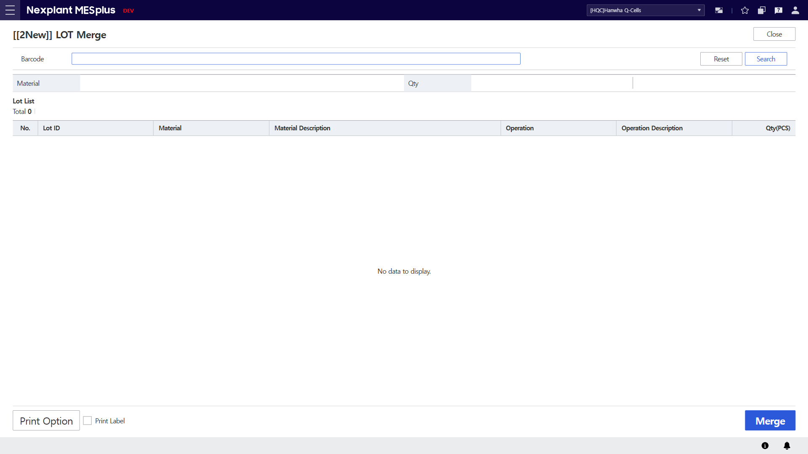
26. LOT Merge
Main Menu | WIP (Production Management) | Sub Menu | LOT Mgt. (LOT 관리) | UI Name | LOT Merge
UI | Description
 | 1) Enter the search conditions to retrieve LOT information. 2) Click the [Search] button to display the requested list in the grid according to the search conditions. 3) Click the [Reset] button to clear all fields on the screen. 4) LOT information will be displayed in the grid. 5) Click the [Merge] button to perform the merge process for the selected LOTs. 6) Click the [Print Option] button to select the printer for label printing. Check the checkbox to print the label when performing the Judge process. 7) Click the [Close] button to exit the OI.
7
1
3
2
4
6
5

Slide 29
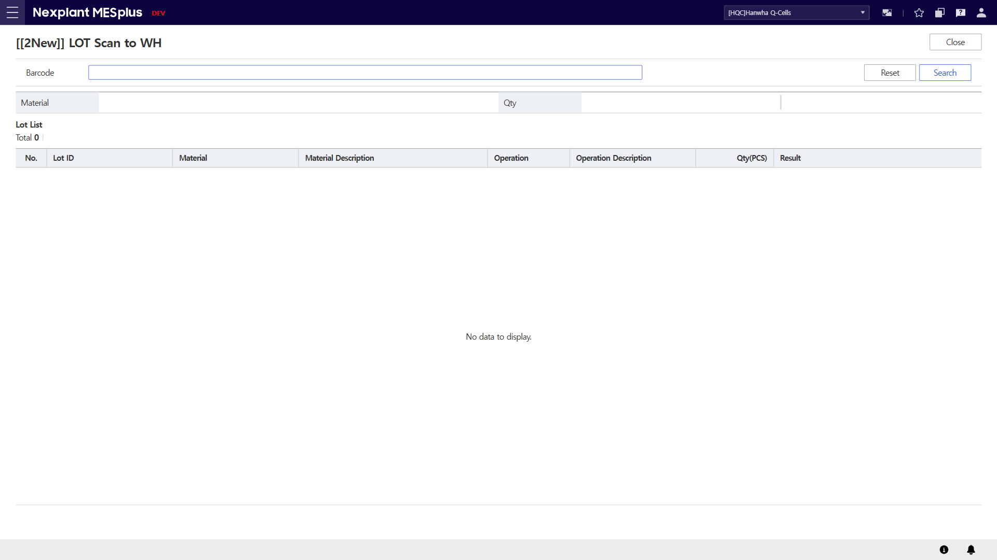
27. LOT Scan to WH
Main Menu | WIP (Production Management) | Sub Menu | LOT Mgt. (LOT 관리) | UI Name | LOT Scan to WH
UI | Description
 | 1) Enter the search conditions to retrieve LOT information. 2) Click the [Search] button to display the requested list in the grid according to the search conditions. 3) Click the [Reset] button to clear all fields on the screen. 4) LOT information will be displayed in the grid. - When the LOT is scanned, the warehouse receiving process will be executed immediately. 5) Click the [Close] button to exit the OI.
5
1
3
2
4

Slide 30
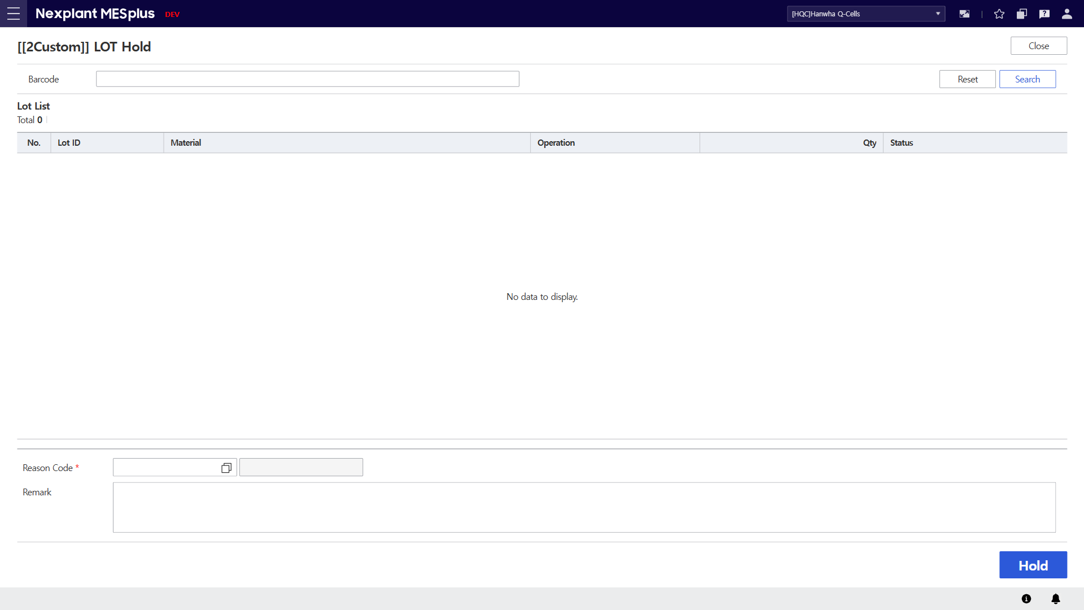
28. LOT Hold (LOT 잠금)
Main Menu | WIP (Production Management) | Sub Menu | LOT Mgt. (LOT 관리) | UI Name | LOT Hold
UI | Description
 | 1) Enter the search conditions to retrieve LOT information. 2) Click the [Search] button to display the requested list in the grid according to the search conditions. 3) Click the [Reset] button to clear all fields on the screen. 4) LOT information will be displayed in the grid. 5) Enter the Reason Code and Remark to perform the Hold process. 6) Click the [Hold] button to perform the Hold process for the selected LOT. 7) Click the [Close] button to exit the OI.
7
1
3
2
4
5
6

Slide 31

29. LOT Release (LOT 잠금해제)
Main Menu | WIP (Production Management) | Sub Menu | LOT Mgt. (LOT 관리) | UI Name | LOT Release
UI | Description
 | 1) Enter the search conditions to retrieve LOT information. 2) Click the [Search] button to display the requested list in the grid according to the search conditions. 3) Click the [Reset] button to clear all fields on the screen. 4) LOT information will be displayed in the grid. 5) Enter the Reason Code and Remark to perform the Release process. 6) Click the [Release] button to perform the Release process for the selected LOT. 7) Click the [Close] button to exit the OI.
7
1
3
2
4
5
2
6

Slide 32
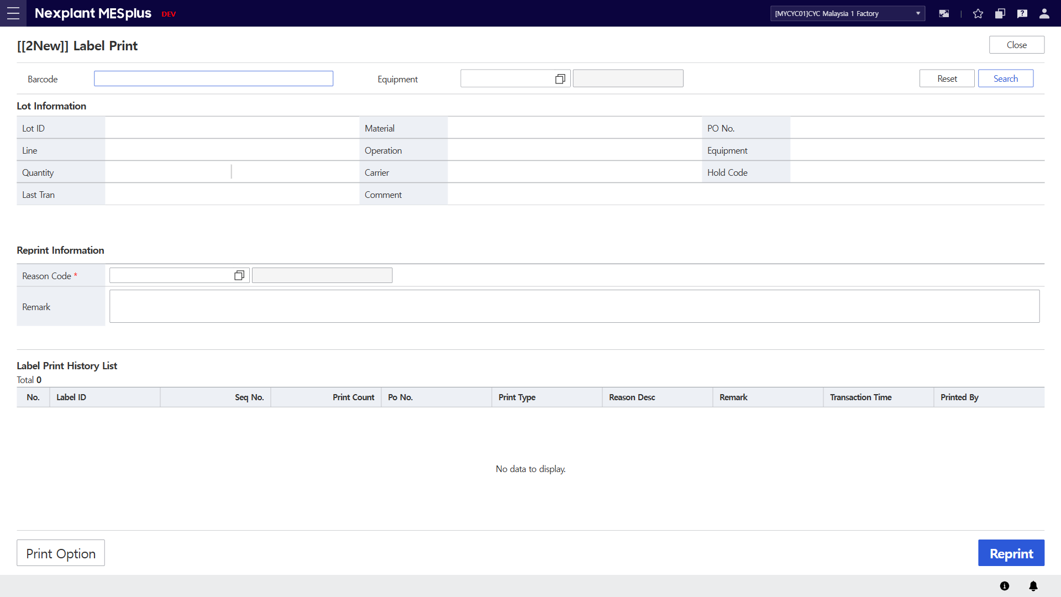
30. Label Print (라벨 발행)
Main Menu | LBL (LBL Management) | Sub Menu | LBL (라벨관리) | UI Name | Label Print | Program ID | 21100
UI | Description
 | 1. Enter or Scan a Barcode to retrieve Lot Information. 2. Click the [Search] button to display the Lot Information and label print histories in the grid according to the search conditions. 3. Click the [Reset] button to clear all fields on the screen. 4. Lot Information will be displayed in the table, including details. 5. Label Print History Lists will be displayed in the grid, including details. 6 Enter the reason for reprint. 7. Click [Print Option] button to setup printer. 8. Click [Reprint] button to print label 9. Click the [Close] button to exit the OI.
9
1
3
2
4
6
5
7
8

Slide 33
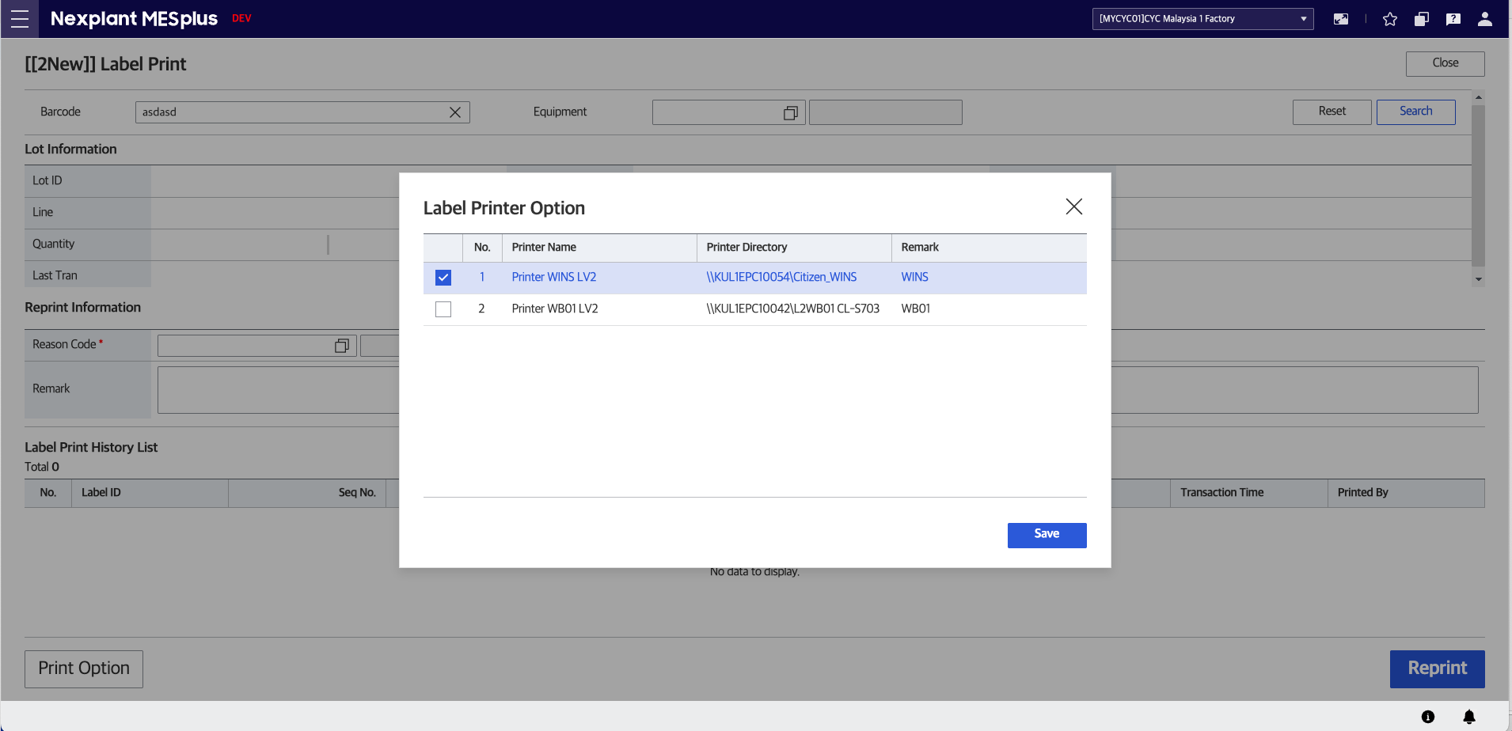
31. Label Print Option (라벨 옵션 설정)
Main Menu | LBL (LBL Management) | Sub Menu | LBL (라벨관리) | UI Name | Label Print Option | Program ID | 21080
UI | Description
 | 1. Select the desired printer using the checkbox. 2. Click [Save] button to confirm print selection.
1
2

Slide 34
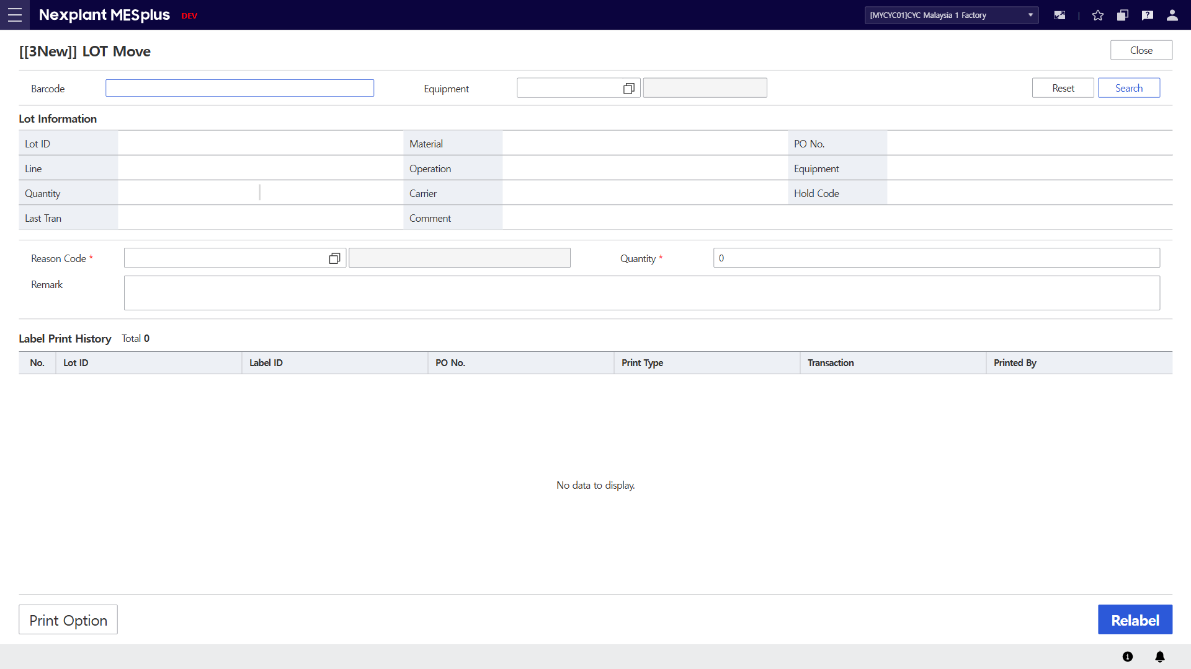
32. Relabel
Main Menu | LBL (LBL Management) | Sub Menu | LBL (라벨관리) | UI Name | Relabel | Program ID | 21105
UI | Description
 | 1. Enter the barcode to retrieve Lot information. 2. Click the [Search] button to display the Lot information according to the search conditions. 3. Click the [Reset] button to clear all fields on the screen. 4. Lot information will be displayed according to the search conditions. 5. Enter the information for relabeling. The quantity must be less than the existing quantity. 6. The Relabel History will be displayed in the grid. Every time a relabel is performed based on the Original Lot ID, it will be saved in the History. 7. Click the [Print Option] button to change the print settings. 8. Click the [Relabel] button to proceed with the relabeling. The relabeled Lot will be newly registered in the OQC inspection list of the existing Original Lot ID. 9. Click the [Close] button to exit the OI.
9
1
3
2
4
5
6
7
8

Slide 35
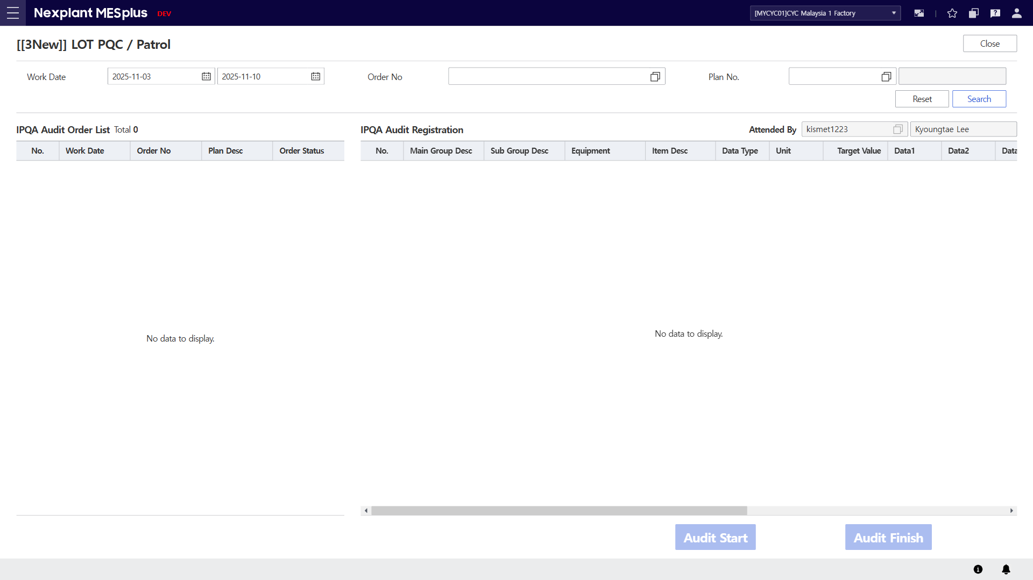
33. LOT PQC / Patrol
Main Menu | QCM (Quality Management) | Sub Menu | PQC (공정검사) | UI Name | LOT PQC / Patrol | Program ID | 21250
UI | Description
 | 1. Enter the search conditions to retrieve IPQA Audit registration list. 2. Click the [Search] button to display the IPQA Audit registration in the grid according to the search conditions. 3. Click the [Reset] button to clear all fields on the screen. 4. "Attended By" is set based on the logged-in account. 5. The IPQA Audit order list will be displayed. 6. The inspection item list of the IPQA Audit will be displayed. 7. Click the [Audit Start] button to Start the inspection. 8. Click the [Audit Finish] button to End the inspection.
1
3
2
4
5
6
7
8

Slide 36
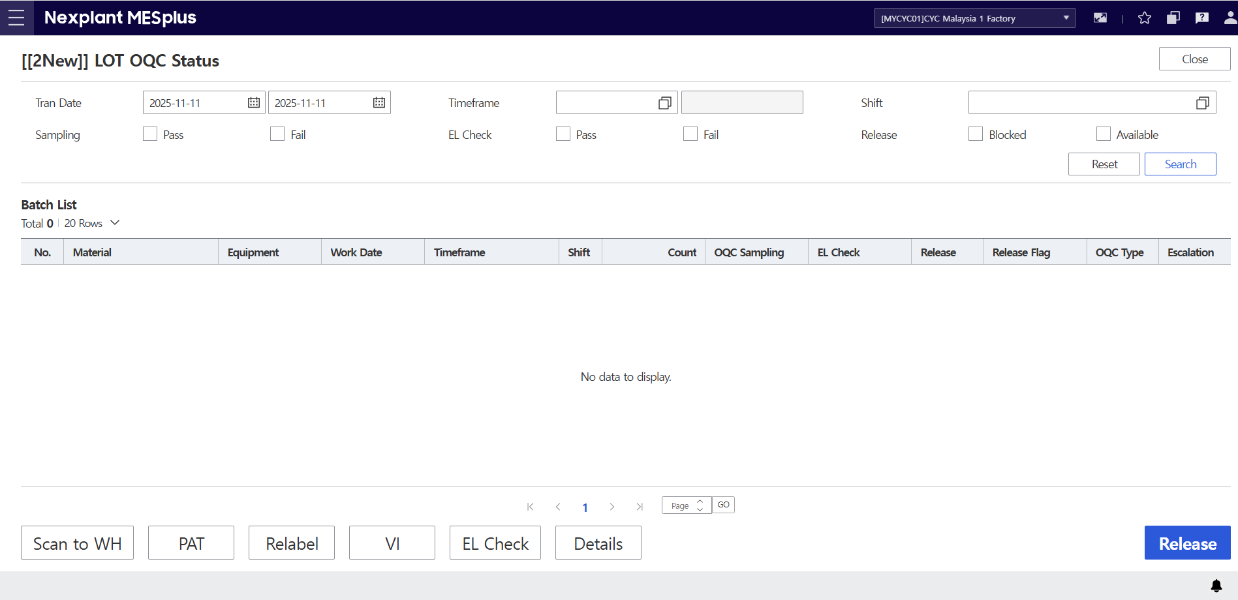
34. LOT OQC Status
Main Menu | QCM (Quality Management) | Sub Menu | OQC (제품검사) | UI Name | LOT OQC Status | Program ID | 21280
UI | Description
 | 1. Enter the search conditions to retrieve OQC Batch list. 2. Click the [Search] button to display the OQC information according to the search conditions. 3. Click the [Reset] button to clear all fields on the screen. 4. The OQC Batch list will be displayed in the grid, including details. 5. Click the [Scan to WH] button to redirect to the Scan to Warehouse screen. 6. Click the [PAT] button to redirect to the Lot Judgment screen, where you can register and make judgments on the PAT list. 7. Click the [Relabel] button to redirect to the Relabel. 8. Click the [VI] button to redirect to the Lot Judgment screen with the default test set to VI. 9. Click the [EL Check] button to redirect to the Lot Judgment screen with the default test set to EL Check.. 10. Click the [Detail] button to redirect to the Lot detail list for that Batch. 11. Click the [Release] button to release the Batch whose final test result is AVAILABLE. 12. Click the [Close] button to exit the OI.
12
1
3
2
4
5
6
7
8
9
10
11

Slide 37
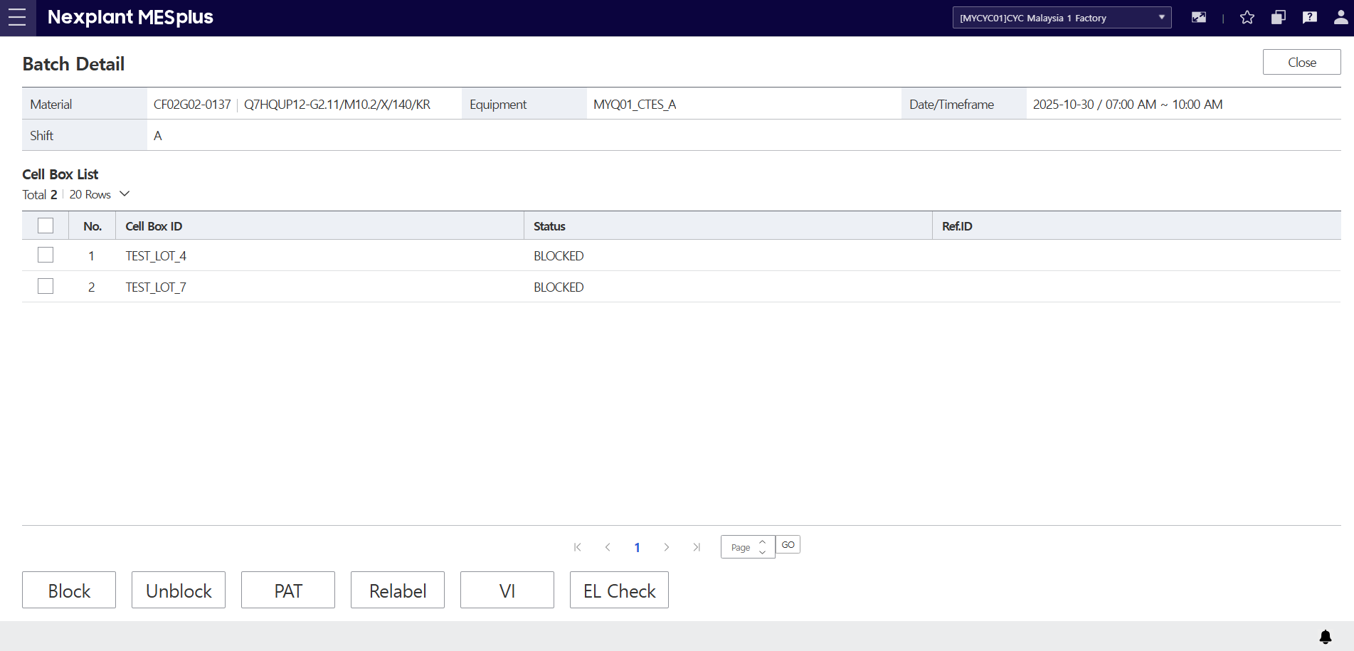
34-1. LOT OQC Status
Main Menu | QCM (Quality Management) | Sub Menu | OQC (제품검사) | UI Name | LOT OQC Status | Program ID | 21280
UI | Description
 | 13. Basic information based on the Timeframe Batch is retrieved. 14. The LOT List based on the Timefram Batch is retrieved. 15. Click the [Block] button to send the checked items from the Lot List to the 'Block (LOT Hold)' screen. 16. Click the [Unblock] button to send the checked items from the Lot List to the 'Unblock (LOT Release)' screen. 17. Click the [PAT] button to send the checked items from the Lot List for PAT Type creation. If no items are checked, this will only navigate to the screen to create a PAT list. 18. Click the [Relabel] button to send the selected LOT's information to the 'Relabel' screen. This action references only the selected row's LOT information, regardless of the checked list. 19. Click the [VI] button to redirect to the Lot Judgment screen with the default test set to VI. If checked items exist in the LOT List, they are added to the VI inspection list. (If an item already exists, its existing value is retrieved.) 20. Click the [EL Check] button to redirect to the Lot Judgment screen with the default test set to EL Check.. If checked items exist in the LOT List, they are added to the VI inspection list. (If an item already exists, its existing value is retrieved.) 21. Click the [Close] button to exit the OI.
21
13
14
15
16
17
18
19
20

Slide 38
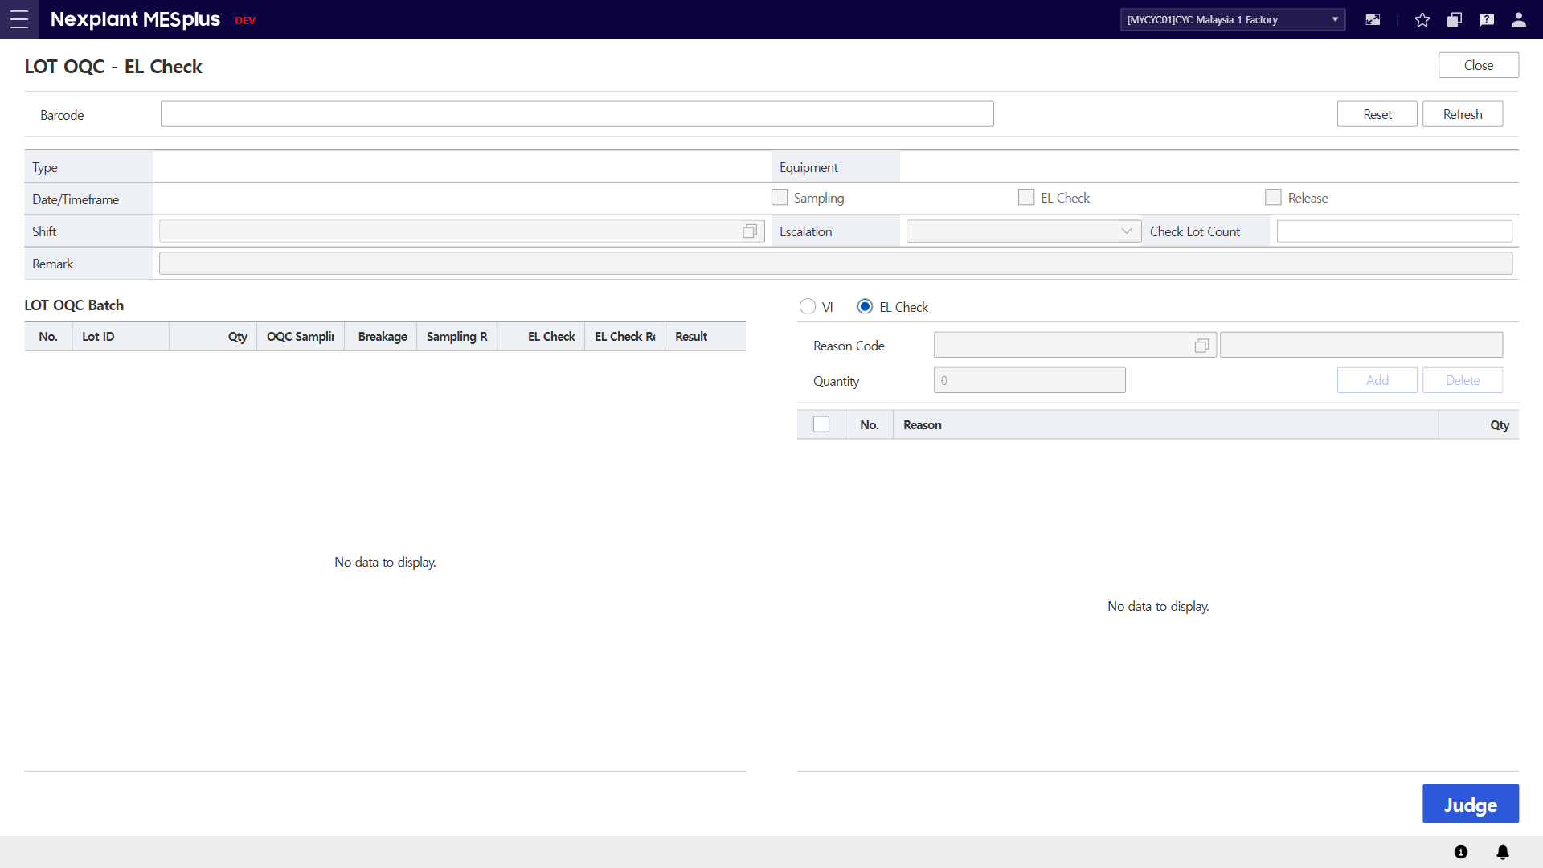
35. LOT OQC Judgement
Main Menu | QCM (Quality Management) | Sub Menu | OQC (제품검사) | UI Name | LOT OQC Judgement | Program ID | 21285
UI | Description
 | 1. Enter the barcode to retrieve OQC Batch information. If the OQC Batch Information has already been retrieved, only Lot IDs included in that Batch can be retrieved. The retrieved Lot information will be added to (4), and if a judgment is made for that Lot, that information will automatically be displayed in (4) when the Batch information is retrieved. 2. Click the [Reset] button to clear all fields on the screen. 3. Click the [Refresh] button to reset, leaving only the saved information for the Batch. 4. The list of Lots inspected in the Batch will be displayed. Retrieved LOT information is not saved to the inspection list until it is processed by [Jugde]. 5. You can select whether to perform the VI (Visual Inspection) test or the EL Check test. If you change this radio button selection, you must re-select the Lot in (4).
1
2
3
5
4

Slide 39
35-1. LOT OQC Judgement
Main Menu | QCM (Quality Management) | Sub Menu | OQC (제품검사) | UI Name | LOT OQC Judgement | Program ID | 21285
UI | Description
 | 6. If an issue occurs, enter the Reason Code and Quantity. The Reason Code SP00 (Breakage due to handling) does not affect the result. 7. Click the [Add] button to add the selected Reason Code and Quantity to the Grid. The changes will not be saved until [Judge] is clicked. 8. Click the [Delete] button to remove the checked items from the grid. The changes will not be saved until [Judge] is clicked. 9. Reason Codes and Quantities are added to or removed from the Grid using the [Add] or [Delete] buttons. When a Lot is selected in the LOT OQC Batch Grid, if there is an existing saved Reason Code List, it will be displayed in the Grid. 10. Click the [Judge] button to save the added Reason Code and Quantity and determine the Test result based on those values. 11. Click the [Close] button to exit the OI.
11
6
7
8
9
10

Slide 40
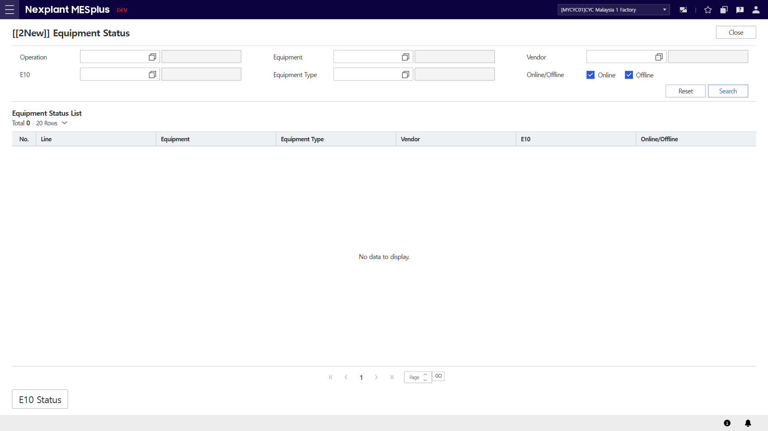
36. Equipment Status
Main Menu | RAS (Equipment Management) | Sub Menu | Equip Mgt. (설비 관리) | UI Name | Equipment Status | Program ID | 21460
UI | Description
 | 1. Enter the search conditions to retrieve Equipment status list. 2. Click the [Search] button to display the Equipment status list in the grid according to the search conditions. 3. Click the [Reset] button to clear all fields on the screen. 4. The equipment status list will be displayed in the grid, including details. 5. Click [E10 Status] button to redirect to selected equipment’s E10 Status OI. 6. Click the [Close] button to exit the OI.
6
1
3
2
4
5

Slide 41
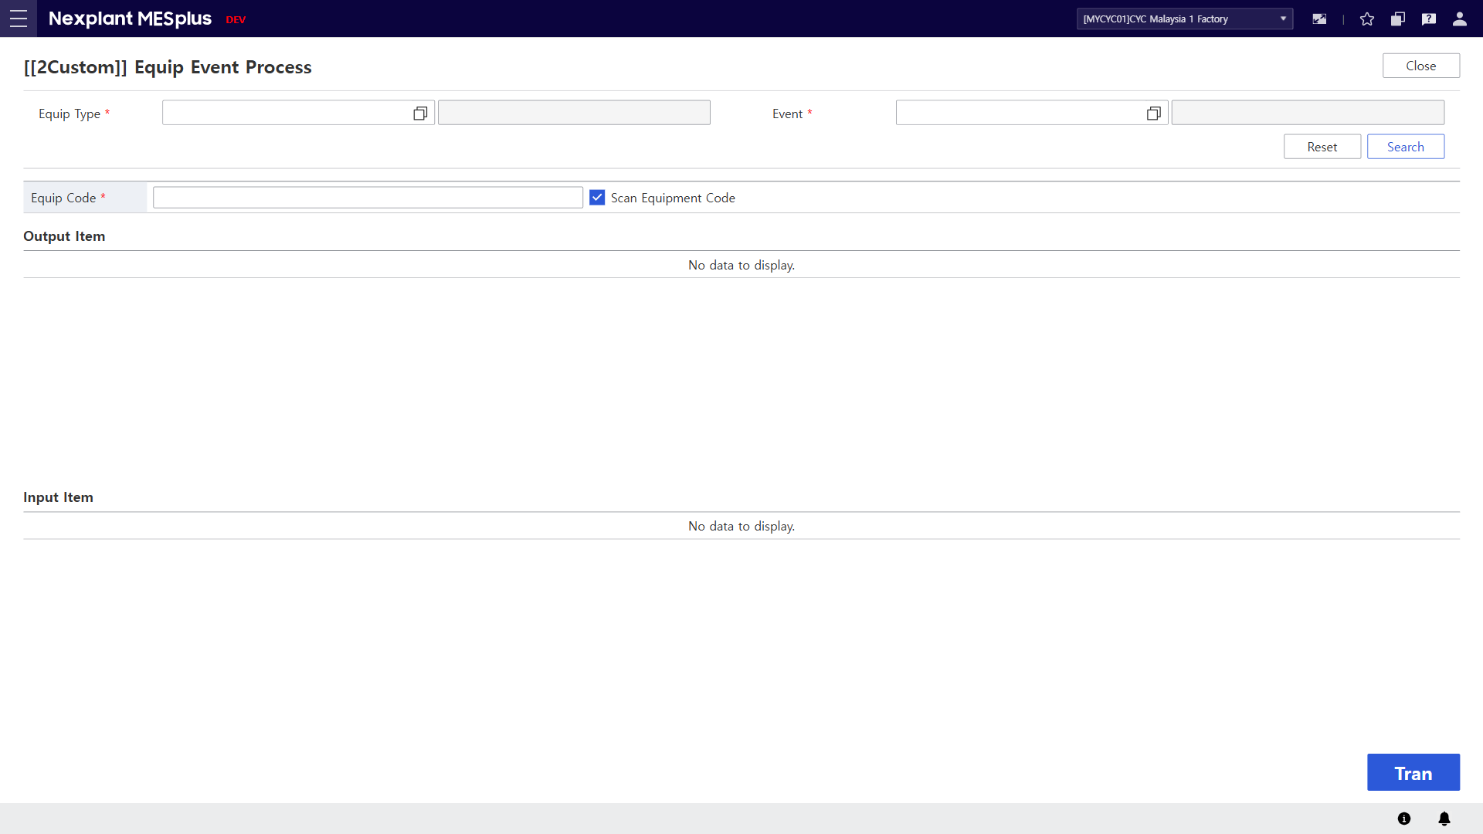
37. Equip Event Process (설비 이벤트)
Main Menu | RAS (Equipment Management) | Sub Menu | Carrier Mgt. (대차관리) | UI Name | Equip Event Process | Program ID | 21465
UI | Description
 | 1. Select the equipment type (configured as Level 3). The events defined for the selected type will be available for selection. 2. Equipment is classified by Scan Check — either through CodeView or manual input. 3. After selecting the equipment, click the [Search] button to retrieve the related equipment items. 4. Click the [Reset] button to clear all fields on the screen. 5. The retrieved equipment items will be displayed in this section. 6. Event input items will be displayed in the corresponding section. 7. Click the [Tran] button to trigger the selected event for the retrieved equipment. 8. Click the [Close] button to exit the OI.
8
1
2
4
3
5
6
7

Slide 42
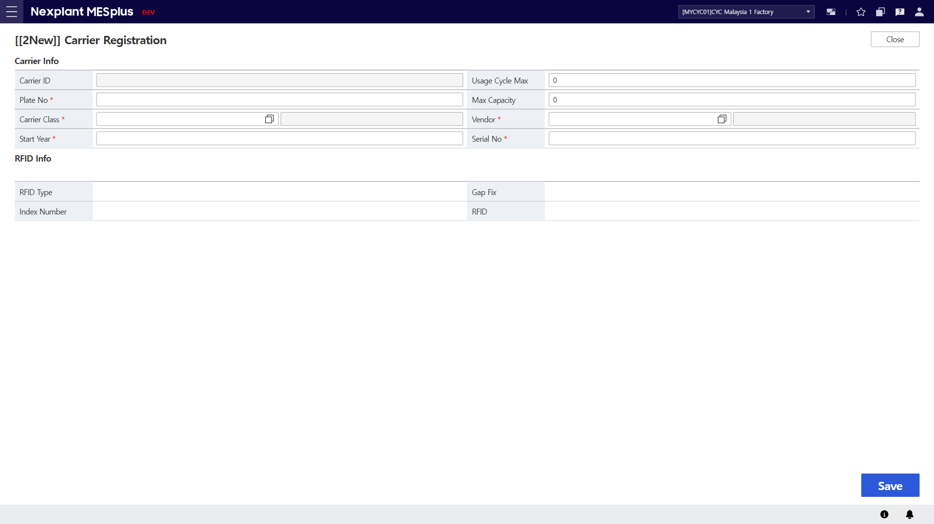
38. Carrier Registration
Main Menu | RAS (Equipment Management) | Sub Menu | Carrier Mgt. (대차관리) | UI Name | Carrier Registration | Program ID | 21535
UI | Description
 | 1. Enter the required information for carrier creation. 2. When the carrier is successfully saved, its RFID information will be retrieved and displayed. 3. Click the [Save] button to create or update the carrier based on the entered information. 4. Click the [Close] button to exit the OI.
4
1
2
3

Slide 43
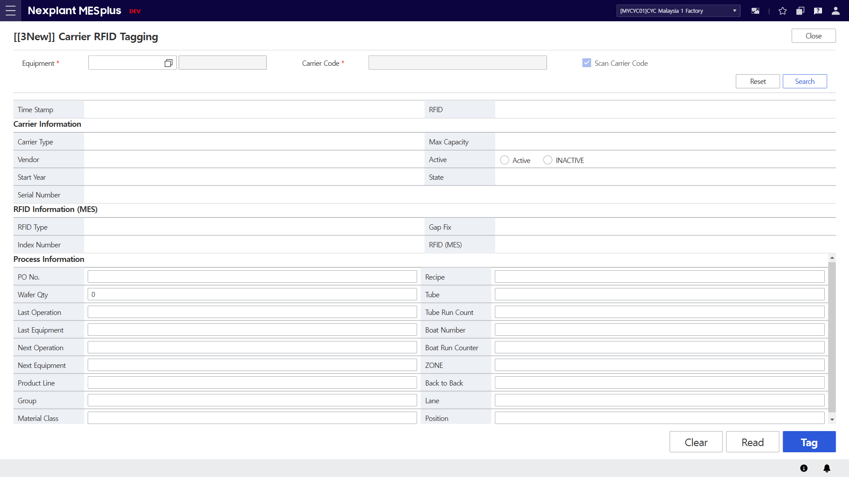
39. Carrier RFID Tagging
Main Menu | RAS (Equipment Management) | Sub Menu | Carrier Mgt. (대차관리) | UI Name | Carrier RFID Tagging | Program ID | 21538
UI | Description
 | 1. Required option that must be selected to enable communication with the Brooks equipment. 2. Click the [Read] button to retrieve Tag information from the equipment. 3. Click the [Clear] button to reset all field data in the Process Information section. 4. Click the [Tag] button to send the entered or initialized Process Information — based on the retrieved Carrier data — to the equipment, where it will be written to the RFID. 5. Field displaying the retrieved Carrier information. 6. Field used for data received from or written to the equipment. 7. This field is activated when the Tag RFID is damaged (e.g., FFFFFFF) or when there is no Carrier corresponding to the Serial Number. When activated, data can be entered according to the Scan Check status, either through CodeView or Scan. 8. Click the [Search] button to retrieve information for the entered or selected Carrier. 9. Click the [Reset] button to clear all fields on the screen. 10. Click the [Close] button to exit the OI.
10
1
7
9
8
5
6
3
2
4

Slide 44

40. Carrier RFID Read/Write
Main Menu | RAS (Equipment Management) | Sub Menu | Carrier Mgt. (대차관리) | UI Name | Carrier RFID Read/Write | Program ID | 21540
UI | Description
 | 1. Required option that must be selected to enable communication with the Brooks equipment. 2. Click the [Read] button to retrieve Tag information from the equipment. 3. Click the [Write] button to send the entered Process Information — based on the retrieved Carrier data — to the equipment, where it will be written to the RFID. 4. Field displaying the retrieved Carrier information. 5. Field used for data received from or written to the equipment. 6. Click the [Close] button to exit the OI.
6
1
4
5
2
3

Slide 45
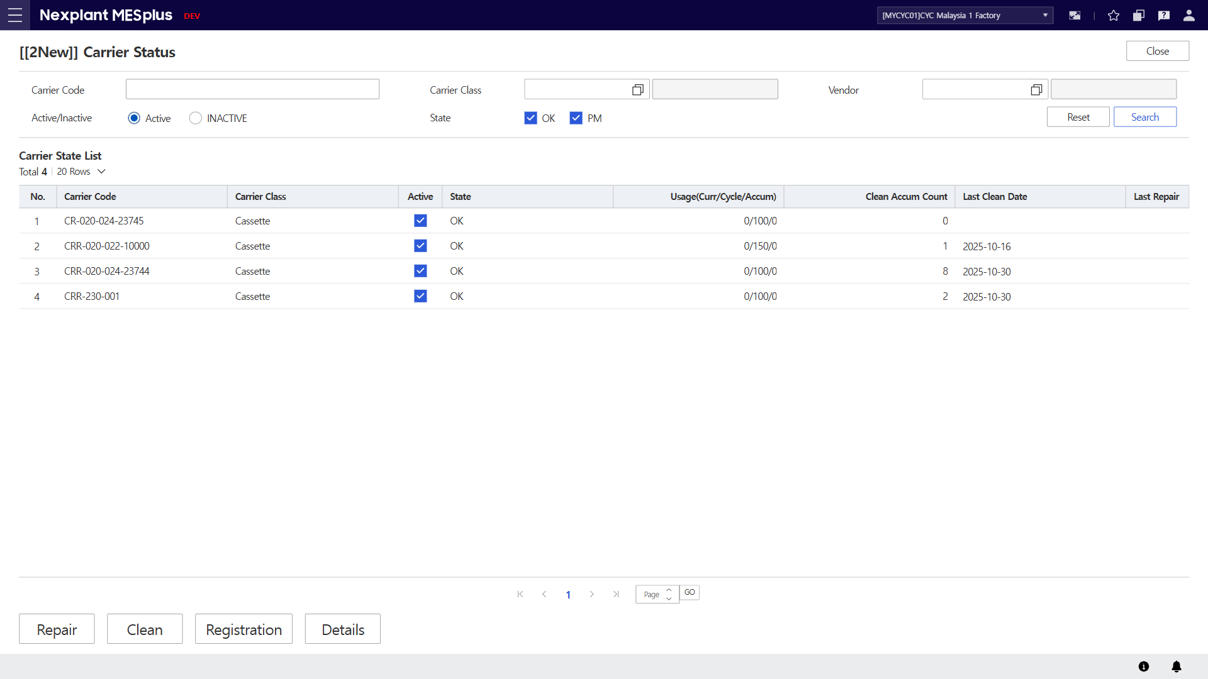
41. Carrier Status
Main Menu | RAS (Equipment Management) | Sub Menu | Carrier Mgt. (대차관리) | UI Name | Carrier Status | Program ID | 21585
UI | Description
 | 1. Enter the search conditions to retrieve Carrier status list. 2. Click the [Search] button to display the Carrier status list in the grid according to the search conditions. 3. Click the [Reset] button to clear all fields on the screen. 4. The carrier status list will be displayed in the grid, including details. 5. Click [Repair] button to redirect to selected carrier’s repair event OI. 6. Click [Clean] button to redirect to selected carrier’s clean event OI. 7. Click [Registaration] button to redirect create carrier process OI. 8. Click [Detail] button to redirect to selected carrier’s information OI. 9. Click the [Close] button to exit the OI.
9
1
3
2
4
5
6
7
8

Slide 46
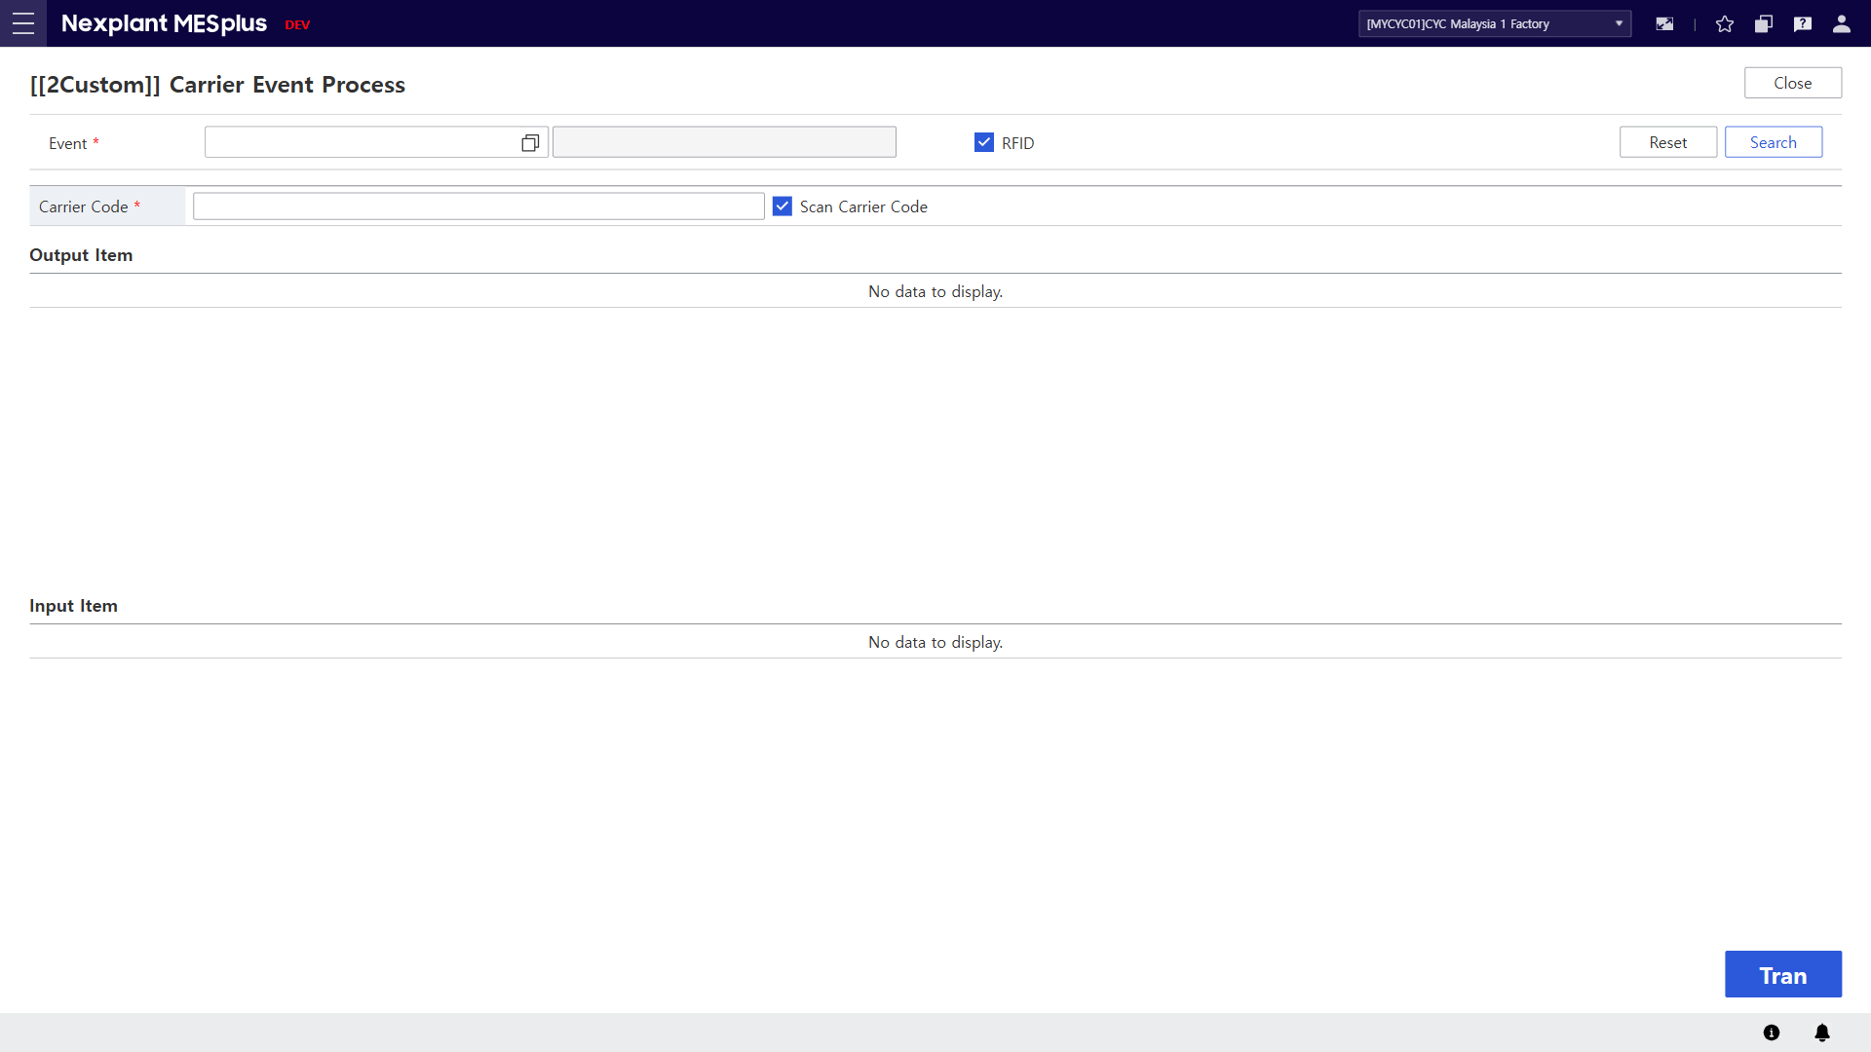
42. Carrier Event Process (캐리어 이벤트)
Main Menu | RAS (Equipment Management) | Sub Menu | Carrier Mgt. (대차관리) | UI Name | Carrier Event Process | Program ID | 21590
UI | Description
 | 1. The event defined according to the RFID check status can be selected. 2. Carrier is classified by Scan Check — either through CodeView or manual input. 3. After selecting the carrier, click the [Search] button to retrieve the related equipment items. 4. Click the [Reset] button to clear all fields on the screen. 5. The retrieved carrier items will be displayed in this section. 6. Event input items will be displayed in the corresponding section. 7. Click the [Tran] button to trigger the selected event for the retrieved carrier. 8. Click the [Close] button to exit the OI.
8
1
4
3
2
5
6
7

Slide 47
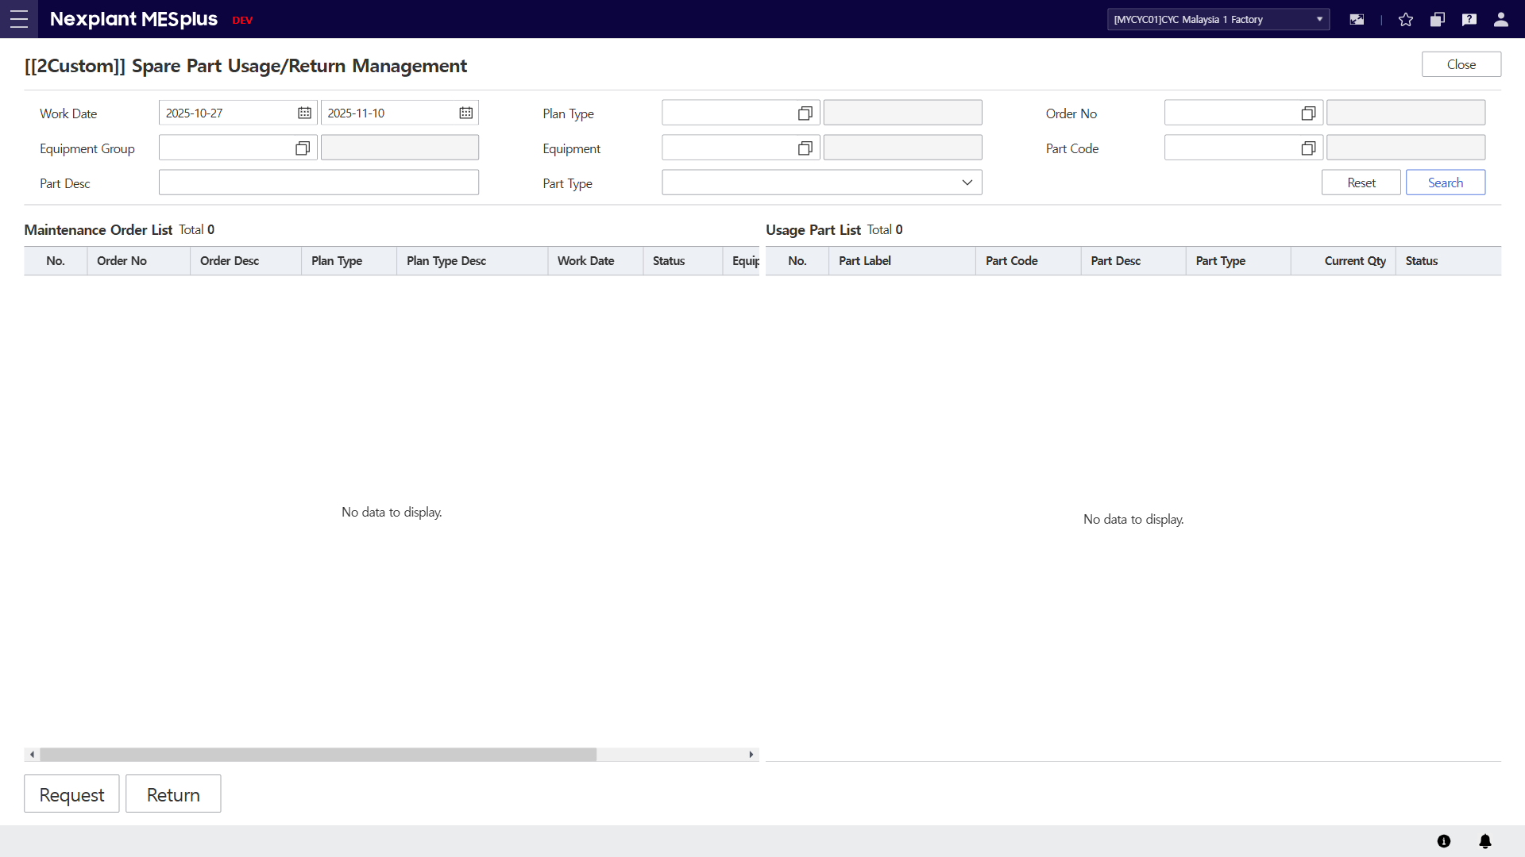
43. Spare Part Usage/Return Management (Spare Part 사용/반납 관리)
Main Menu | FMS (Equipment Maintenance) | Sub Menu | Spare Part (부품관리) | UI Name | Spare Part Usage/Return Management | Program ID | 60134
UI | Description
 | 1. Enter the search conditions to retrieve Part Usage list. 2. Click the [Search] button to display in the grid according to the search conditions. 3. Click the [Reset] button to clear all fields on the screen. 4. The maintenance work order list will be displayed in the grid. 5. The list of spare parts in use will be displayed. 6. Moves to the screen for issuing spare parts internally. 7. Moves to the screen for returning spare parts internally.
1
3
2
4
5
6
7

Slide 48
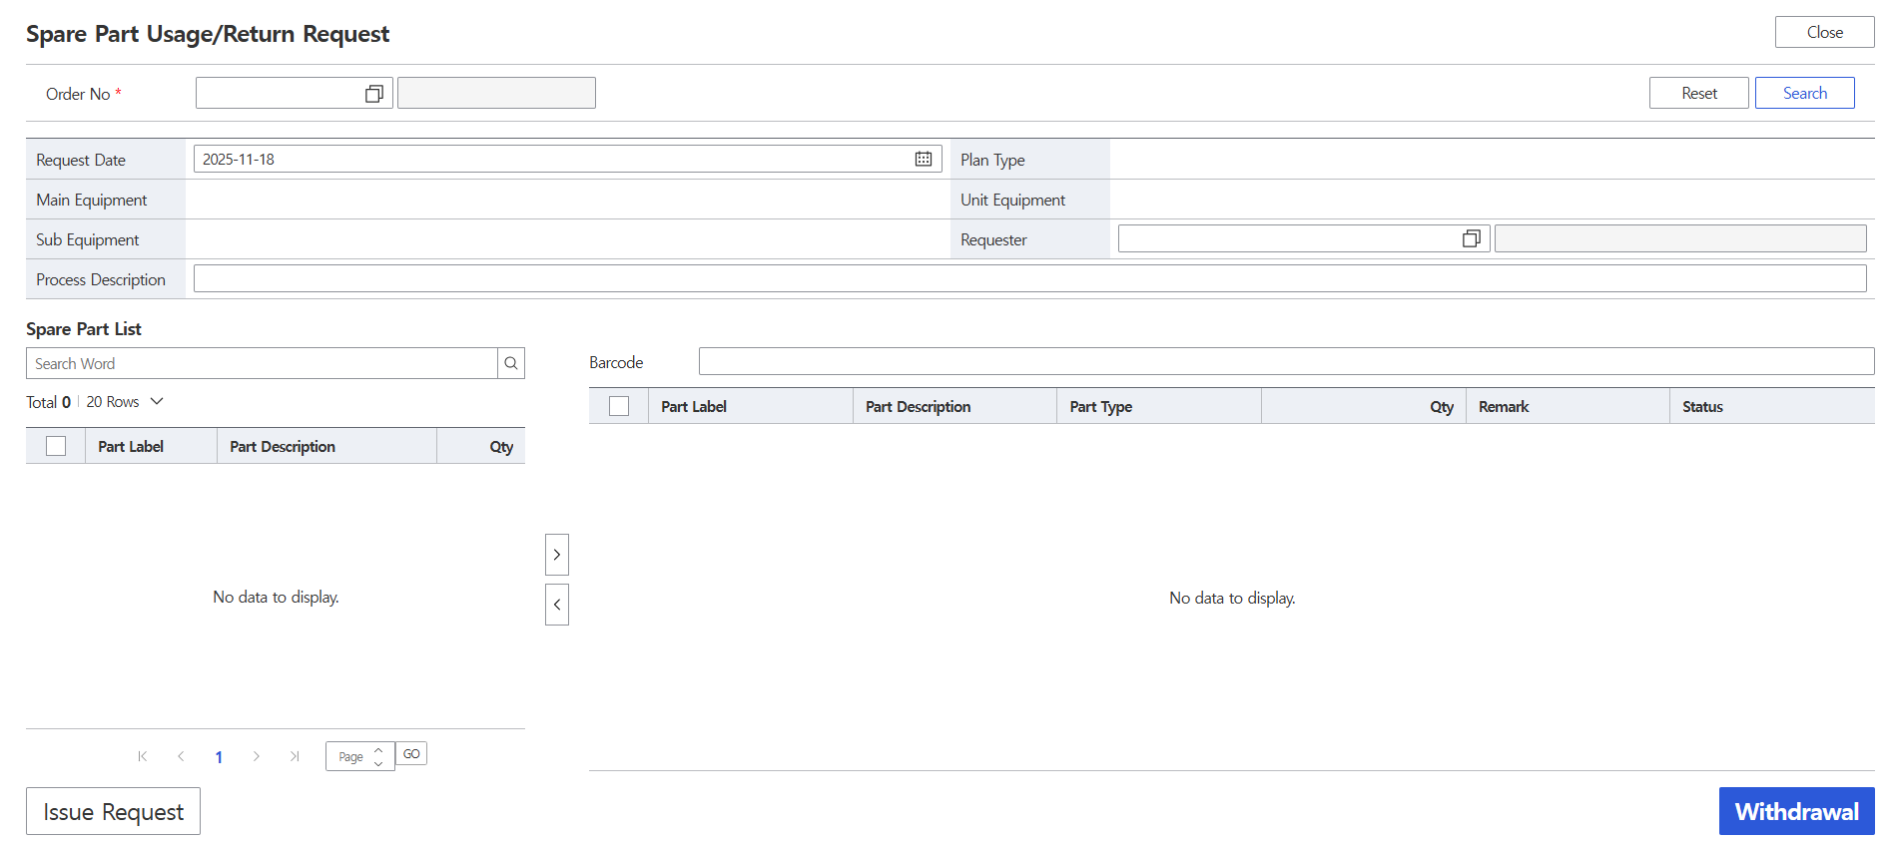
43-1. Spare Part Usage/Return Management (Spare Part 사용/반납 관리)
Main Menu | FMS (Equipment Maintenance) | Sub Menu | Spare Part (부품관리) | UI Name | Spare Part Usage/Return Management | Program ID | 60134
UI | Description
 | 1. Enter the search conditions. 2. Click the [Search] button to display in the grid according to the search conditions. 3. Click the [Reset] button to clear all fields on the screen. 4. Set the attribute values. 5. Scan the label to search. 6. The spare part label list will be displayed. Parts with a Part Label value are in stock, while those without are out of stock. 7. The spare parts to be used for the specified work order number will be displayed. 8. Moves to the screen for processing issue requests for materials without a label value or out of stock. 9. Click the [Withdrawal] button to Process the input of spare parts.
3
2
1
4
5
6
7
8
9

Slide 49
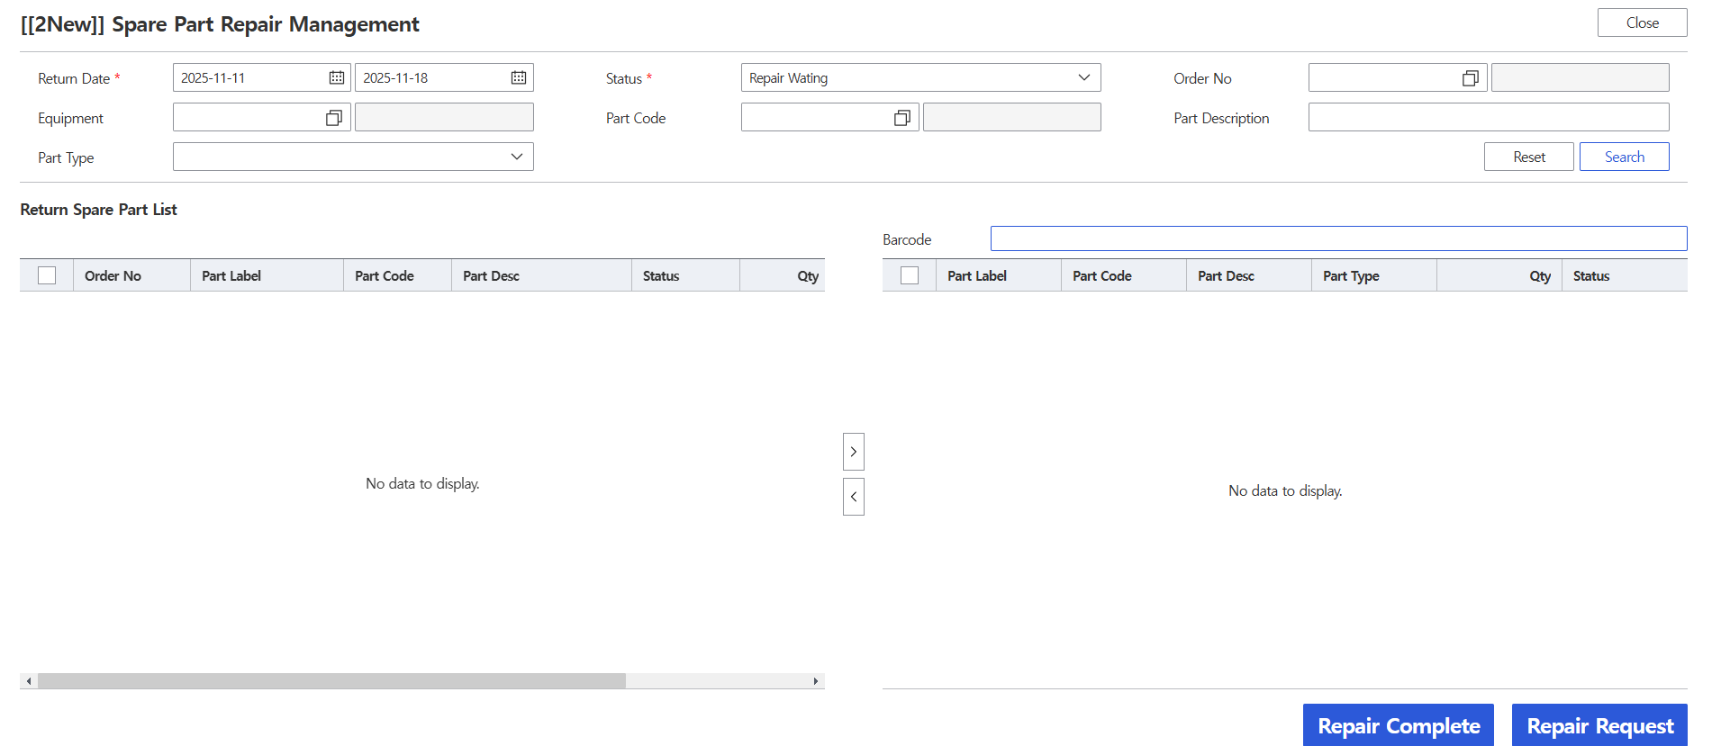
43-2. Spare Part Usage/Return Management (Spare Part 사용/반납 관리)
Main Menu | FMS (Equipment Maintenance) | Sub Menu | Spare Part (부품관리) | UI Name | Spare Part Usage/Return Management | Program ID | 60134
UI | Description
 | 1. Enter the search conditions. 2. Click the [Search] button to display in the grid according to the search conditions. 3. Click the [Reset] button to clear all fields on the screen. 4. Scan the label to search. 5. The list of returned or repaired spare parts will be displayed. 6. The list of parts requested for repair or already repaired will be displayed. 7. Click the [Repair Complete] button to Process the repair completion.. 8. Click the [Repair Request] button to Process the repair request..
1
3
2
5
4
6
7
8

Slide 50
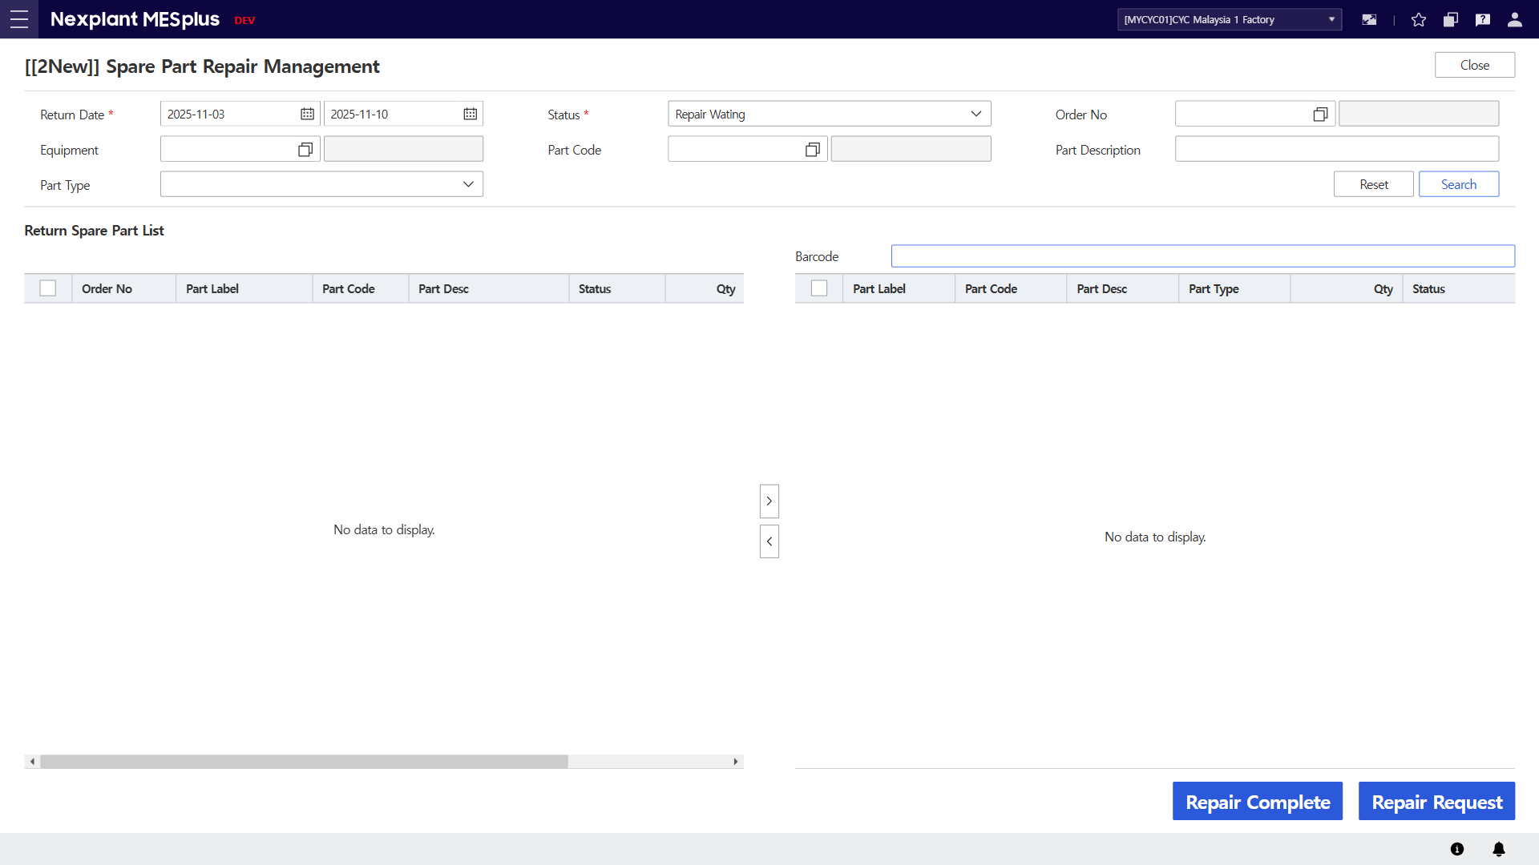
44. Spare Part Repair Management (Spare Part 수리 관리)
Main Menu | FMS (Equipment Maintenance) | Sub Menu | Spare Part (부품관리) | UI Name | Spare Part Repair Management | Program ID | 60136
UI | Description
1
2
3

Slide 51
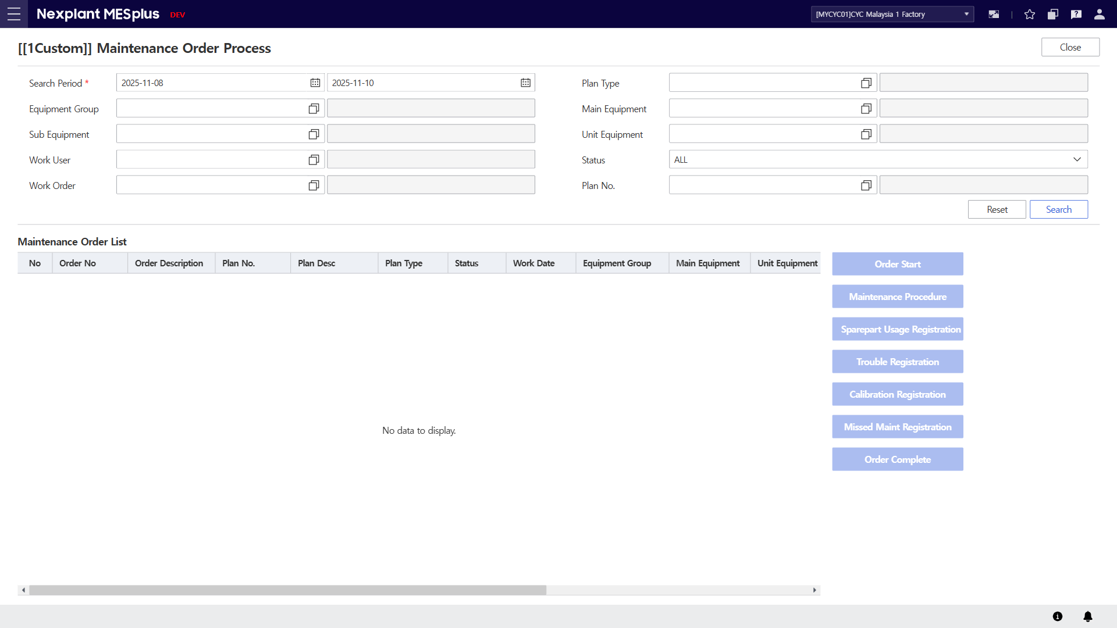
45. Maintenace Order Process (정비 작업지시 조회 및 실행)
Main Menu | FMS (Equipment Maintenance) | Sub Menu | Maintenance Management (정비 관리) | UI Name | Maintenace Order Process | Program ID | 60150
UI | Description
 | 1. Enter the search conditions 2. Click the [Search] button to display the Maintenance Order in the grid according to the search conditions. 3. Click the [Reset] button to clear all fields on the screen. 4. The Maintenance order list will be displayed. 5. Click the [Order Start] button to Start the maintenance work. 6. Click the [Maintenance Procedure] button to A popup window for registering the result values of the maintenance work procedure will be created. 7. Click the [Sparepart Usage Registartion] button to Creates a popup to register the use of spare parts. 8. Click the [Trouble Registration] button to Creates a popup to register the status of equipment with issues. 9. Click the [Calibration Registration] button to Creates a popup to register the measurement results of the measuring instrument.
1
3
2
5
4
6
7
8
9
10
11

Slide 52
45-1. Maintenace Order Process (정비 작업지시 조회 및 실행)
Main Menu | FMS (Equipment Maintenance) | Sub Menu | Maintenance Management (정비 관리) | UI Name | Maintenace Order Process | Program ID | 60150
UI | Description
 | 10. Click the [Missed Maint Registration] button to Creates a popup to register the reason for not performing the maintenance work. 11. Click the [Order Complete] button to Complete the maintenance work order.
1
3
2
5
4
6
7
8
9
10
11

Slide 53
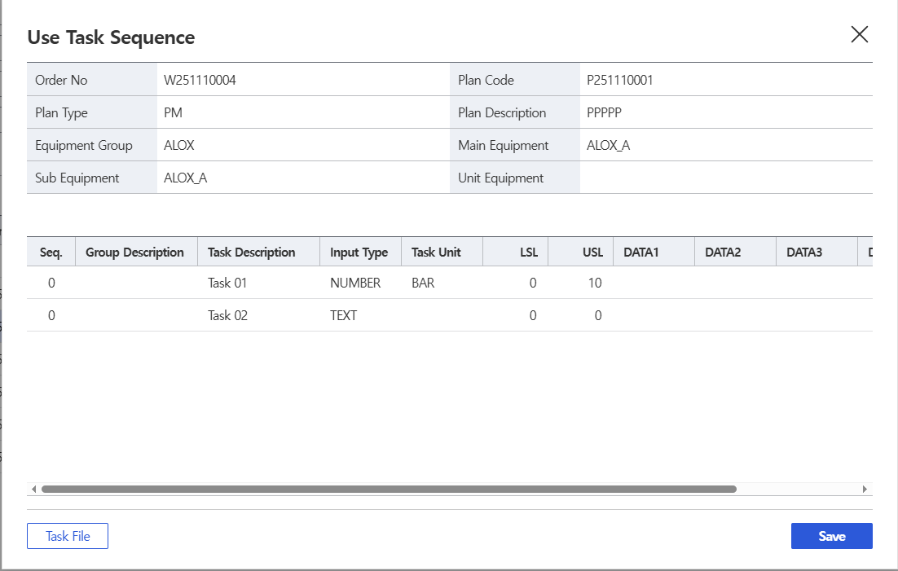
45-2. Maintenace Order Process (정비 작업지시 조회 및 실행)
Main Menu | FMS (Equipment Maintenance) | Sub Menu | Maintenance Management (정비 관리) | UI Name | Maintenace Order Process | Program ID | 60150
UI | Description
 | 1. The information of the maintenance work order will be displayed. 2. The procedure list of the maintenance work order will be displayed. 3. Enter the result or measurement values for the work order item. You can enter up to 5 values. 4. Upload the necessary files during the work procedure. 5. Click the [Save] button to maintenance work procedure.
1
2
3
4
5

Slide 54
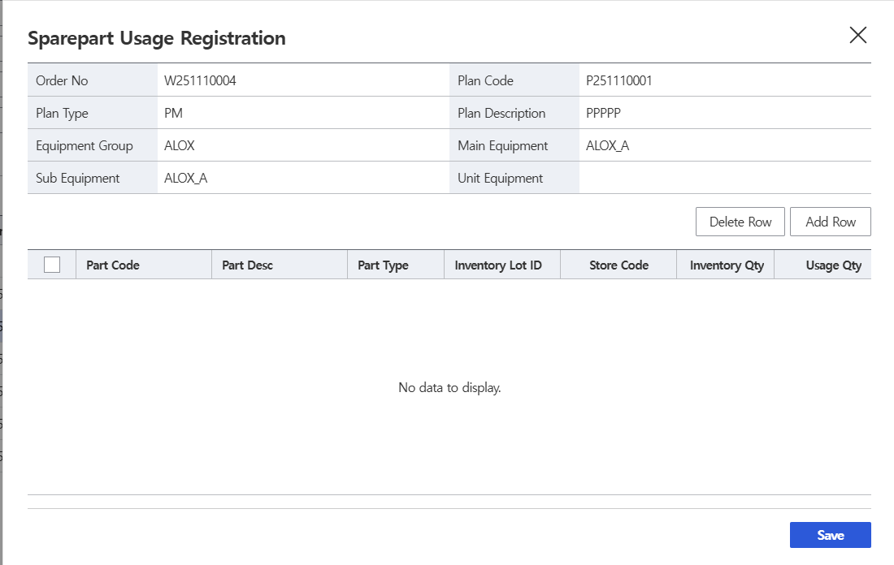
45-3. Maintenace Order Process (정비 작업지시 조회 및 실행)
Main Menu | FMS (Equipment Maintenance) | Sub Menu | Maintenance Management (정비 관리) | UI Name | Maintenace Order Process | Program ID | 60150
UI | Description
 | 1. The information of the maintenance work order will be displayed. 2. The list of spare parts to be used will be displayed. 3. Click the [Add Row] button to Add the spare parts to be used. 4. Click the [Delete Row] button to Delete the added spare parts. 5. Click the [Save] button to Process the use of spare parts.
1
4
3
2
5

Slide 55
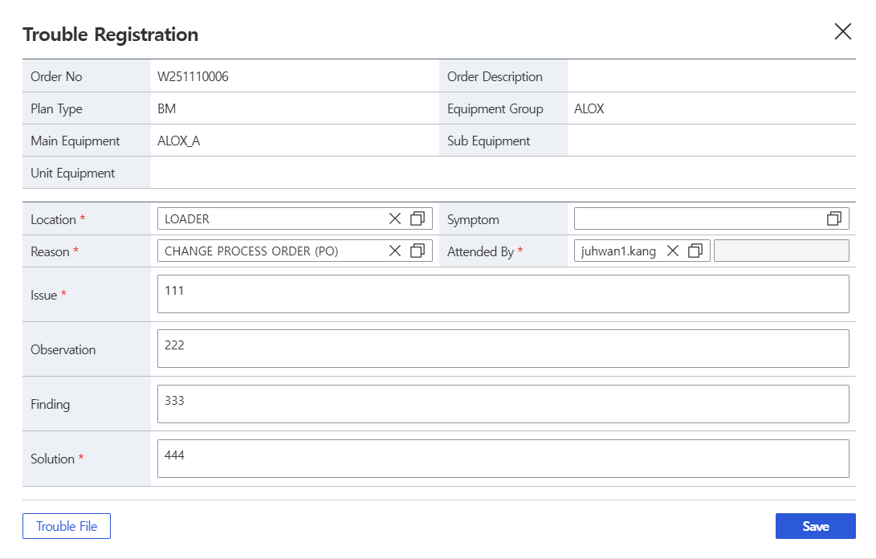
45-4. Maintenace Order Process (정비 작업지시 조회 및 실행)
Main Menu | FMS (Equipment Maintenance) | Sub Menu | Maintenance Management (정비 관리) | UI Name | Maintenace Order Process | Program ID | 60150
UI | Description
 | 1. The information of the maintenance work order will be displayed. 2. Register the equipment issues. 3. Upload the necessary files during the trouble. 4. Click the [Save] button to Save the trouble.
1
2
3
4

Slide 56
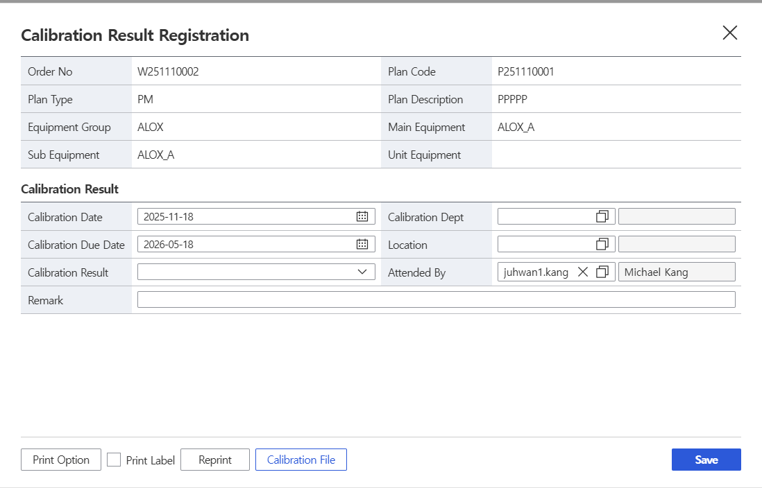
45-5. Maintenace Order Process (정비 작업지시 조회 및 실행)
Main Menu | FMS (Equipment Maintenance) | Sub Menu | Maintenance Management (정비 관리) | UI Name | Maintenace Order Process | Program ID | 60150
UI | Description
 | 1. The information of the maintenance work order will be displayed. 2. Register the measuring instrument’s measurement results. 3. Set the print options. 4. Process the label reissue. 5. Upload the necessary files during the calibration. 6. Click the [Save] button to Save the Calibration.
1
2
3
4
5
6

Slide 57
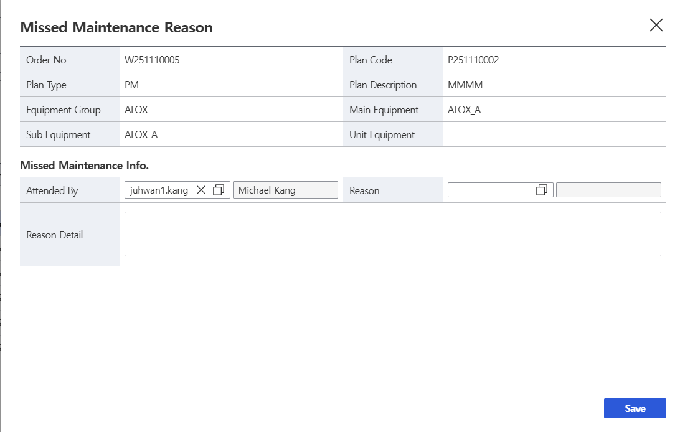
45-6. Maintenace Order Process (정비 작업지시 조회 및 실행)
Main Menu | FMS (Equipment Maintenance) | Sub Menu | Maintenance Management (정비 관리) | UI Name | Maintenace Order Process | Program ID | 60150
UI | Description
 | 1. The information of the maintenance work order will be displayed. 2. Enter the reason for not performing the maintenance. 3. Click the [Save] button to Save the Missed Maintenance Reason.
1
2
3

Slide 58

46. Lot Loss Tracking
Main Menu | EDC (데이터수집) | Sub Menu | EDC (데이터수집) | UI Name | Lot Loss Tracking | Program ID | 21890
UI | Description
 | 1. Enter the search conditions to retrieve paste lot loss list. 2. Click the [Search] button to retrieve material information 3. Click the [Reset] button to clear all fields on the screen. 4. Input lot loss information to create lot loss. 5. List of lot loss will be displayed. 6. Click the [Create] button to create lot loss according to input information. 7. Click the [Edit] button to edit Qty and Remark information. 8. Click the [Delete] button to delete checked lot lost item. 9. Click the [Close] button to exit the OI.
9
1
3
2
4
5
8
7
6

